Slide 1
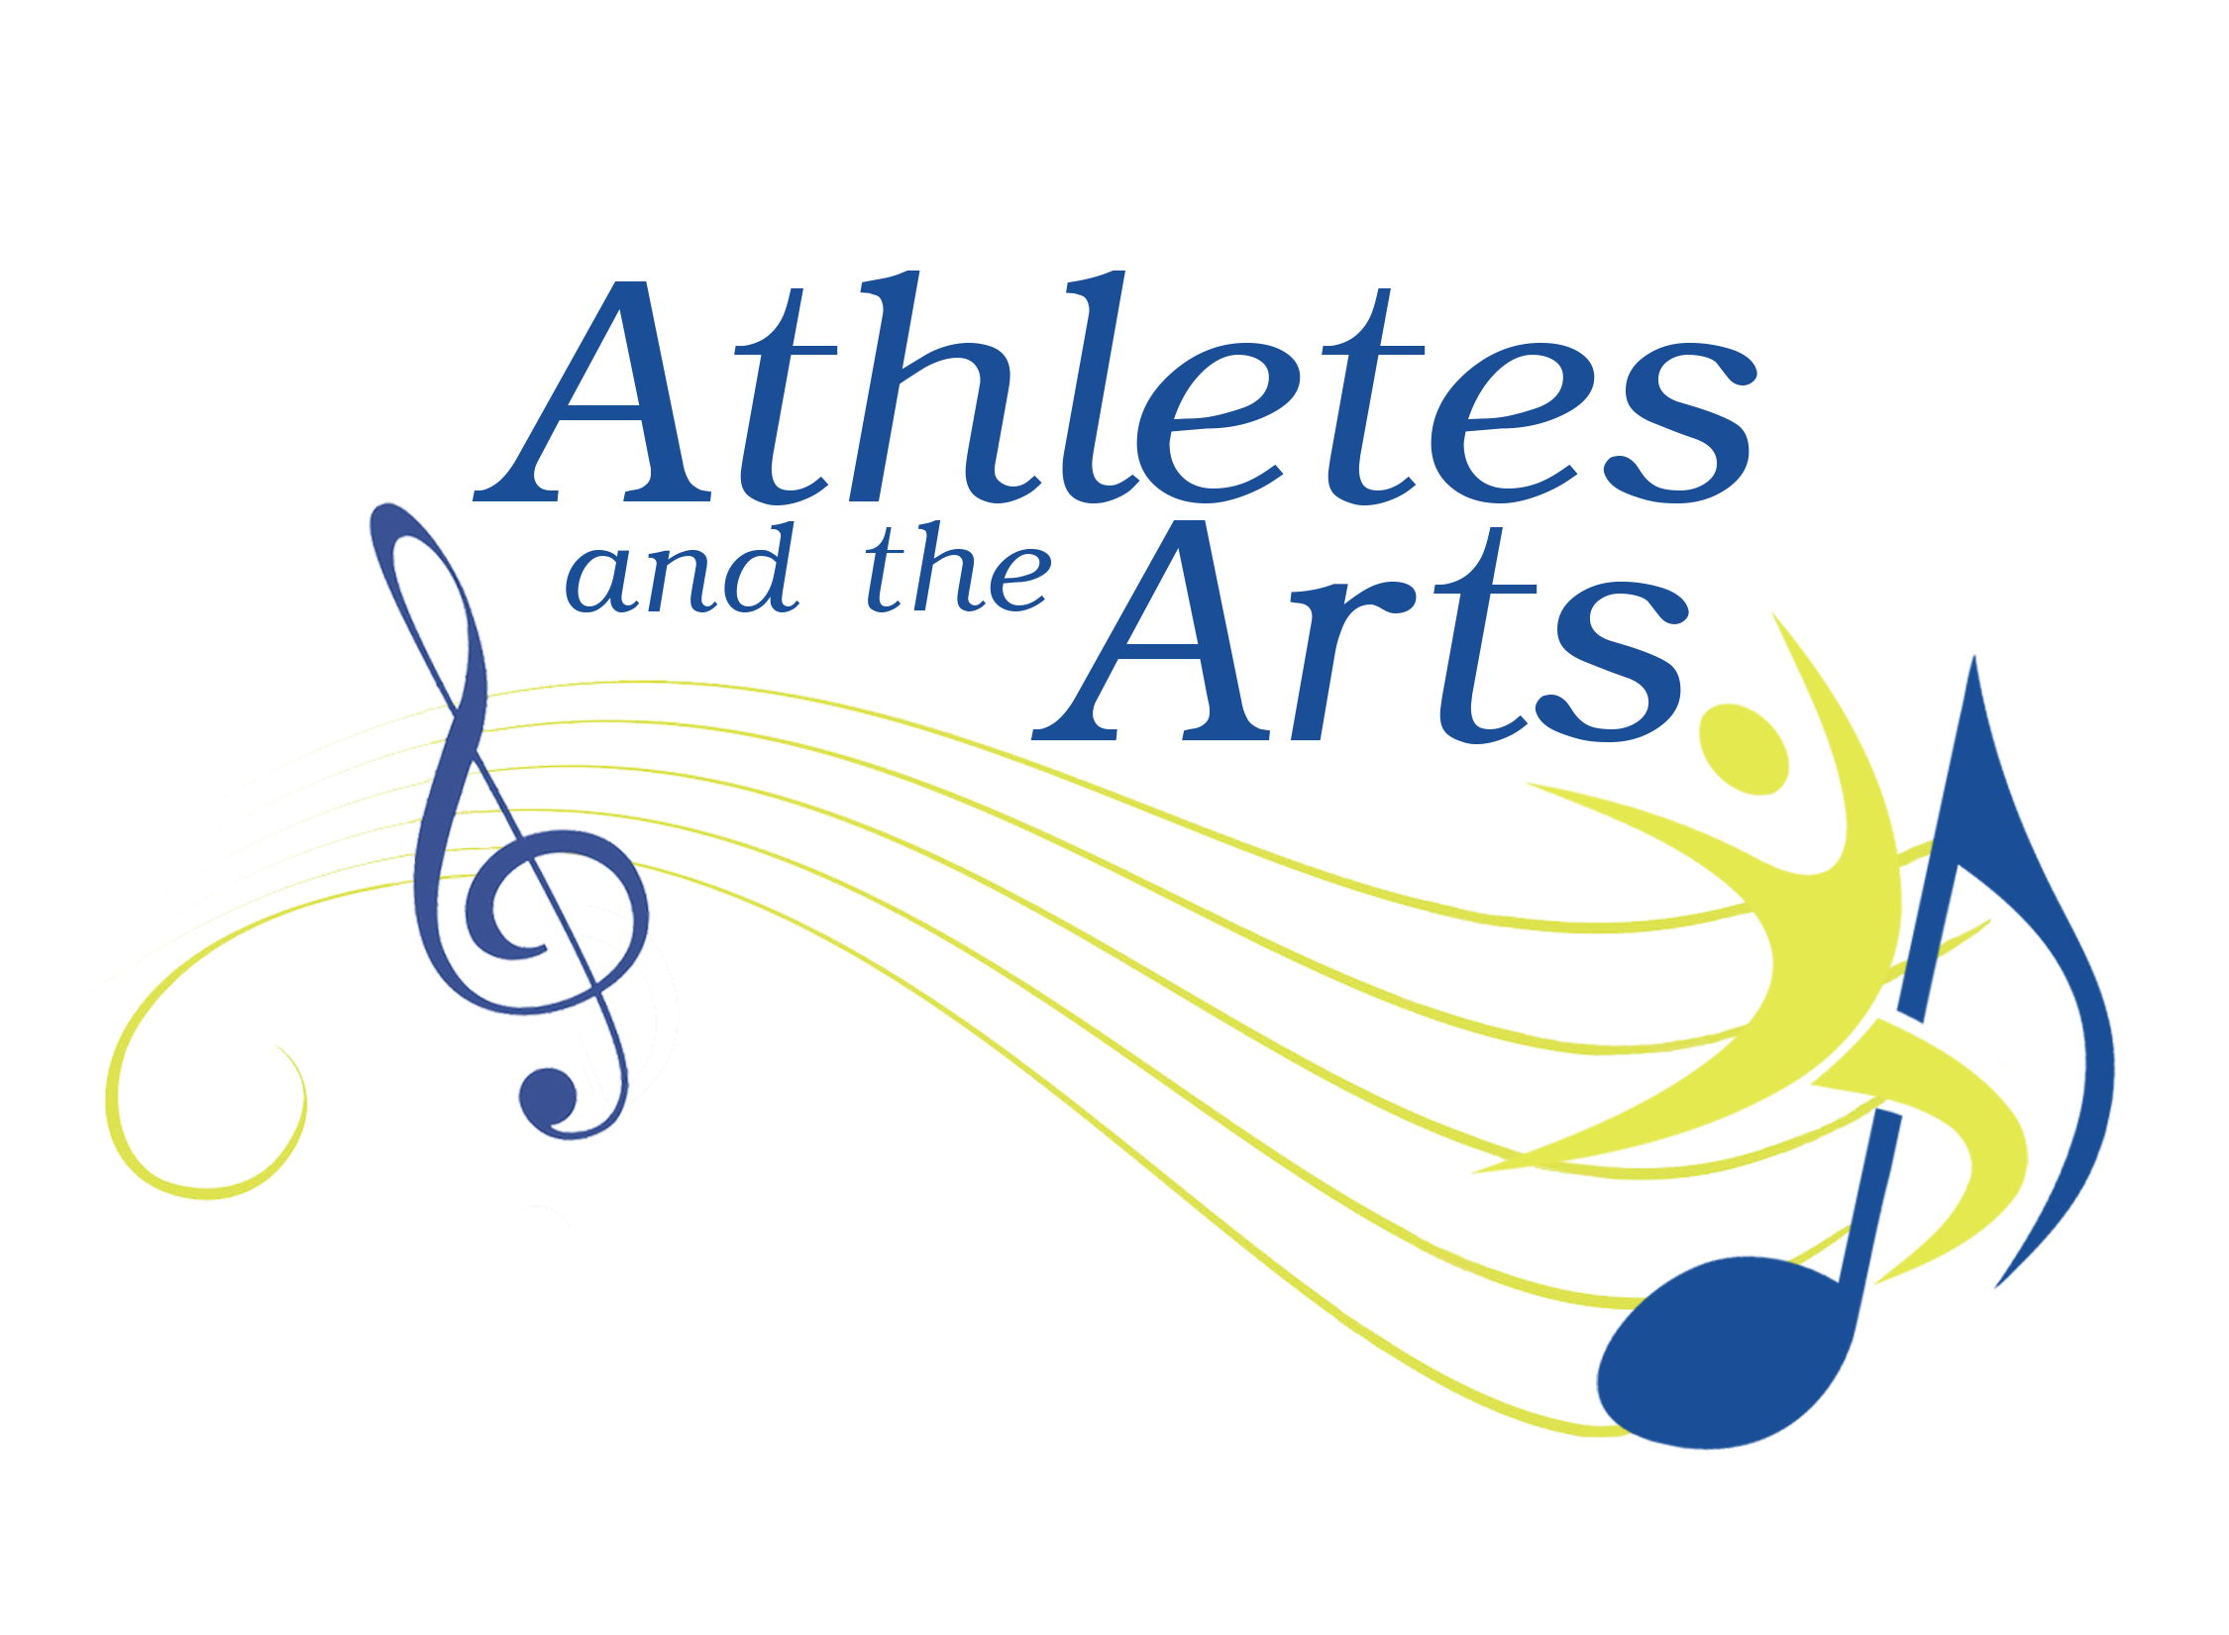
Meeting name
http://athletesandthearts.com
Notes:
Show 3 minute video and then go to this slide

Slide 2
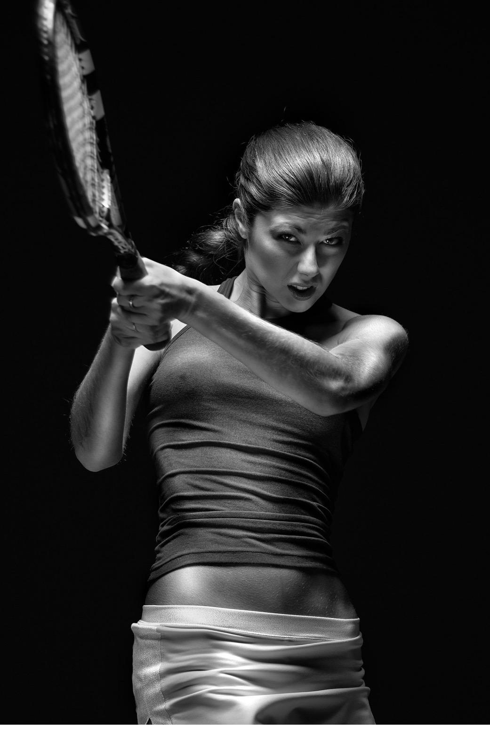
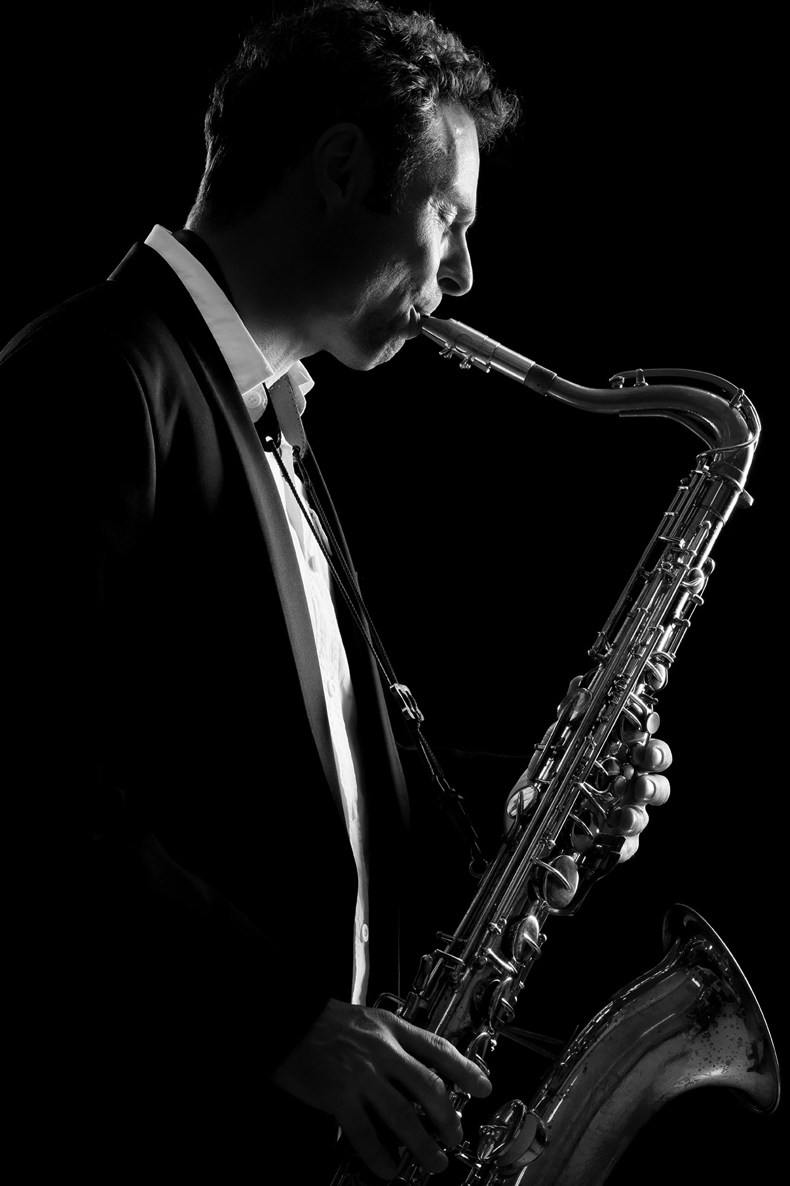
Performing Artist? Competitive Athlete?
Practice or play every day
Play through pain
Perform at all times of day or night
Compete in challenging environments
Little “off season”
Pressure to succeed
Real risk of career-threatening injury
Notes:
Both groups face these issues

Slide 3
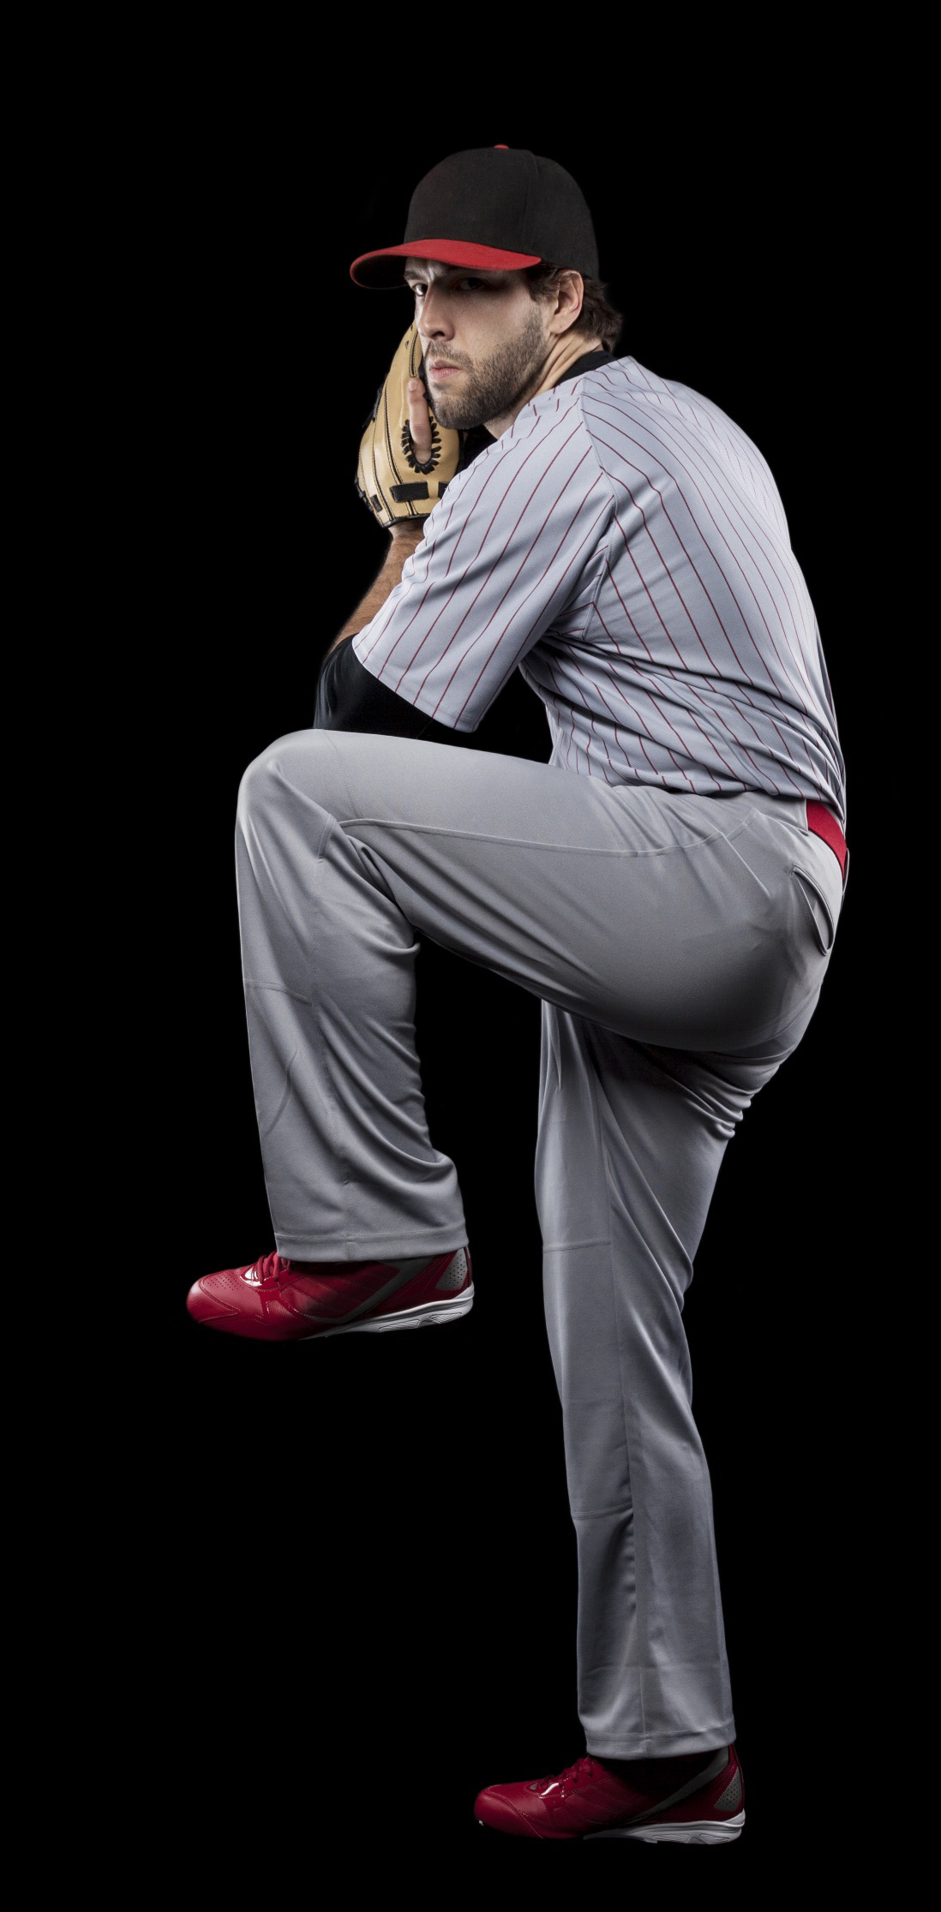

Baseball “Lifestyle”
Arrive at 5 pm
Pre event meal
Warm up / Video
Start at 8 pm
End at 11 pm
Post-event meal
Recovery / Unwind
Travel to new city

Slide 4

Athletes + Performers: Shared Issues
Travel / jet lag
Nutrition / hydration
Overuse
Optimize performance
Mental health
Notes:
Other issues may be easier to address as they are a regular part of the sport athlete education/support. However, even here be aware of the nuance a performing artist brings.

Slide 5
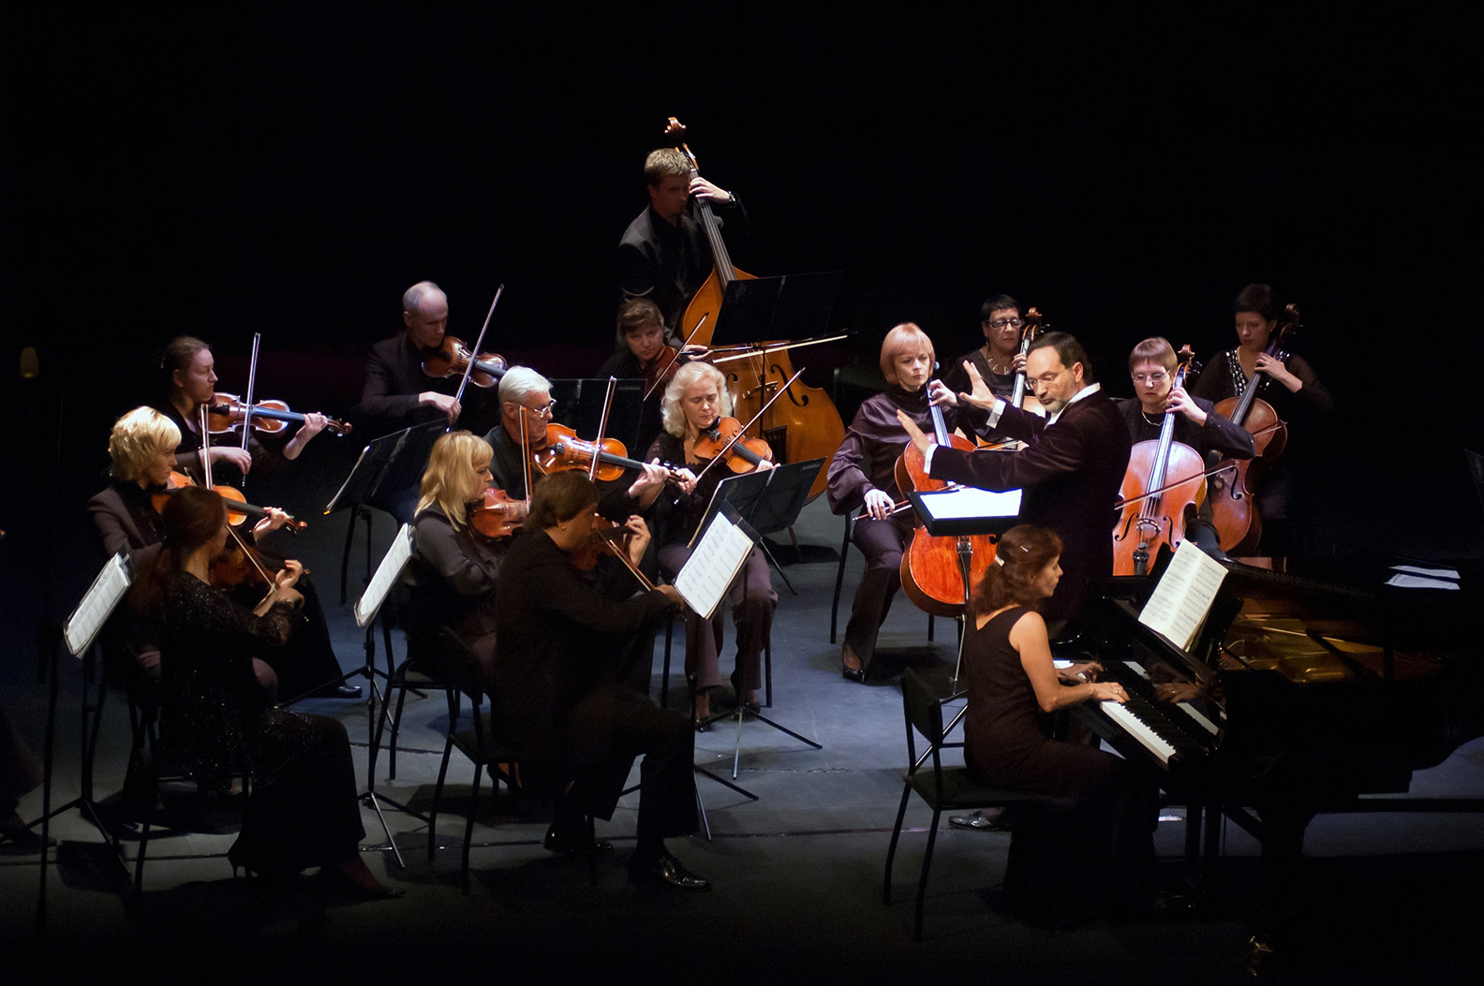
FOUNDING Coalition Partners
American College of Sports Medicine (ACSM)
Center for Music Arts Entrepreneurship, Loyola Univ. (New Orleans)
Performing Arts Medicine Association (PAMA)
Notes:
Current collaborating organizations – a good mix of sports medicine and performing arts. Top 3 (bolded) were original partner organizations
Jonathon Batiste is our artist in residence

Slide 6
Current Coalition Partners
American Academy of Podiatric Sports Medicine (AAPSM)
American Medical Society for Sports Medicine (AMSSM)
American Osteopathic Academy of Sports Medicine (AOASM)
Association for Applied Sports Psychology (AASP)
Drum Corp International (DCI)
Music Teachers National Association (MTNA)
MusiCares
National Association for Music Education (NAfME)
National Association of Teachers of Singing (NATS)
National Athletic Trainers’ Association (NATA)
National Hearing Conservation Association
New Orleans Performing Artists Clinic (NOMC)
The Voice Foundation (VF)
Notes:
Current collaborating organizations – a good mix of sports medicine and performing arts. Top 3 (bolded) were original partner organizations
Jonathon Batiste is our artist in residence

Slide 7

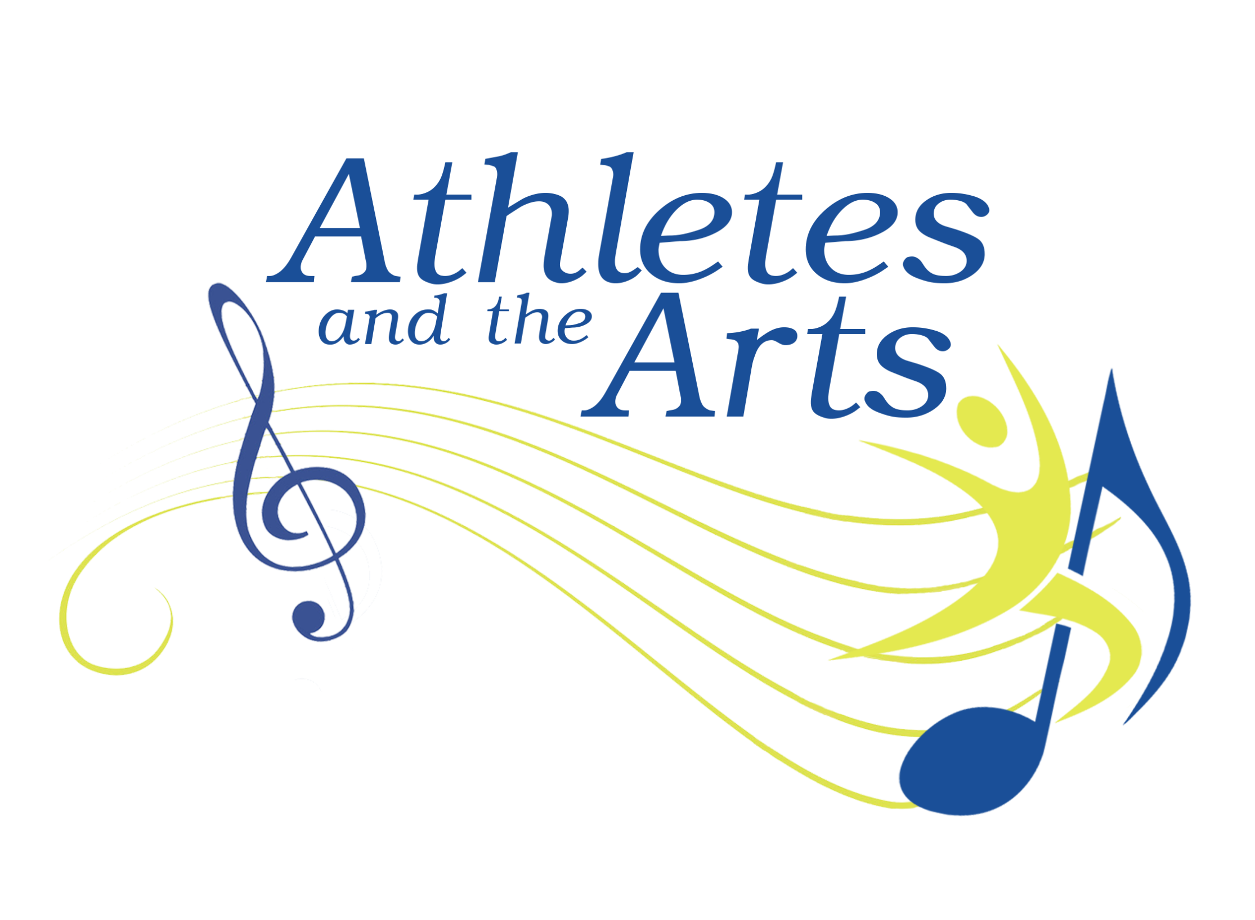
MISSION
Integrating the science of sport and the performing arts for mutual benefit
http://athletesandthearts.com
Notes:
We know a lot about how to improve the health and performance of our sport athletes through baseline testing, pre-participation exams, nutrition, hydration, targeted strength and aerobic training, film study and injury prevention programs. Many of these same attributes are important for the performing artist yet need to be applied in a unique way.

Slide 8
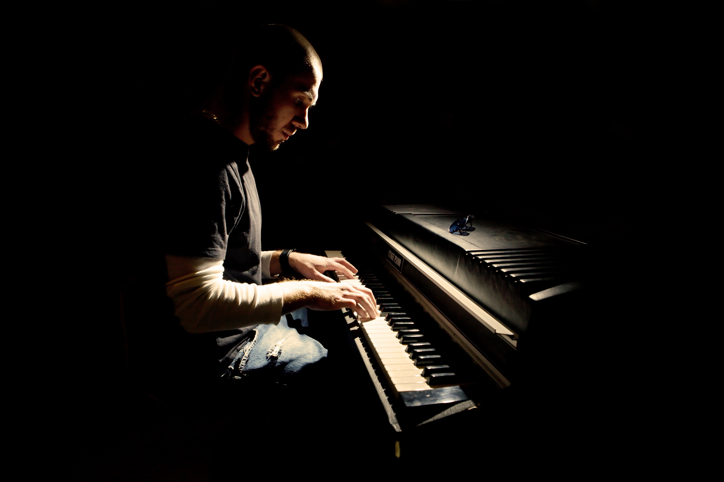
Issues
64% of World Class Drum Corps members had stress fractures (2013)
50% of musicians have some form of Noise – Induced Hearing Loss (NIHL)
75% of orchestra instrumentalists will develop at least one MSK disorders from playing during their lifetimes
67% to 95% of pro ballet and modern dancers suffer injuries annually
    (2-7 injuries per dancer)

Slide 9
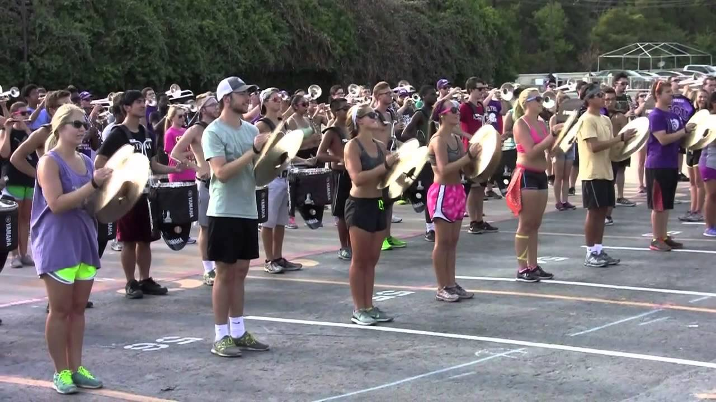
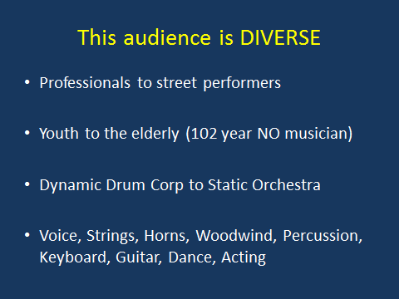
This audience is DIVERSE
Professional to street performers
Youth to the elderly (102 y.o. New Orleans musician
Dynamic Drum Corp to Static Orchestra
Voice, Strings, Horns, Woodwind, Percussion, Keyboard, Guitar, Dance Acting

Slide 10
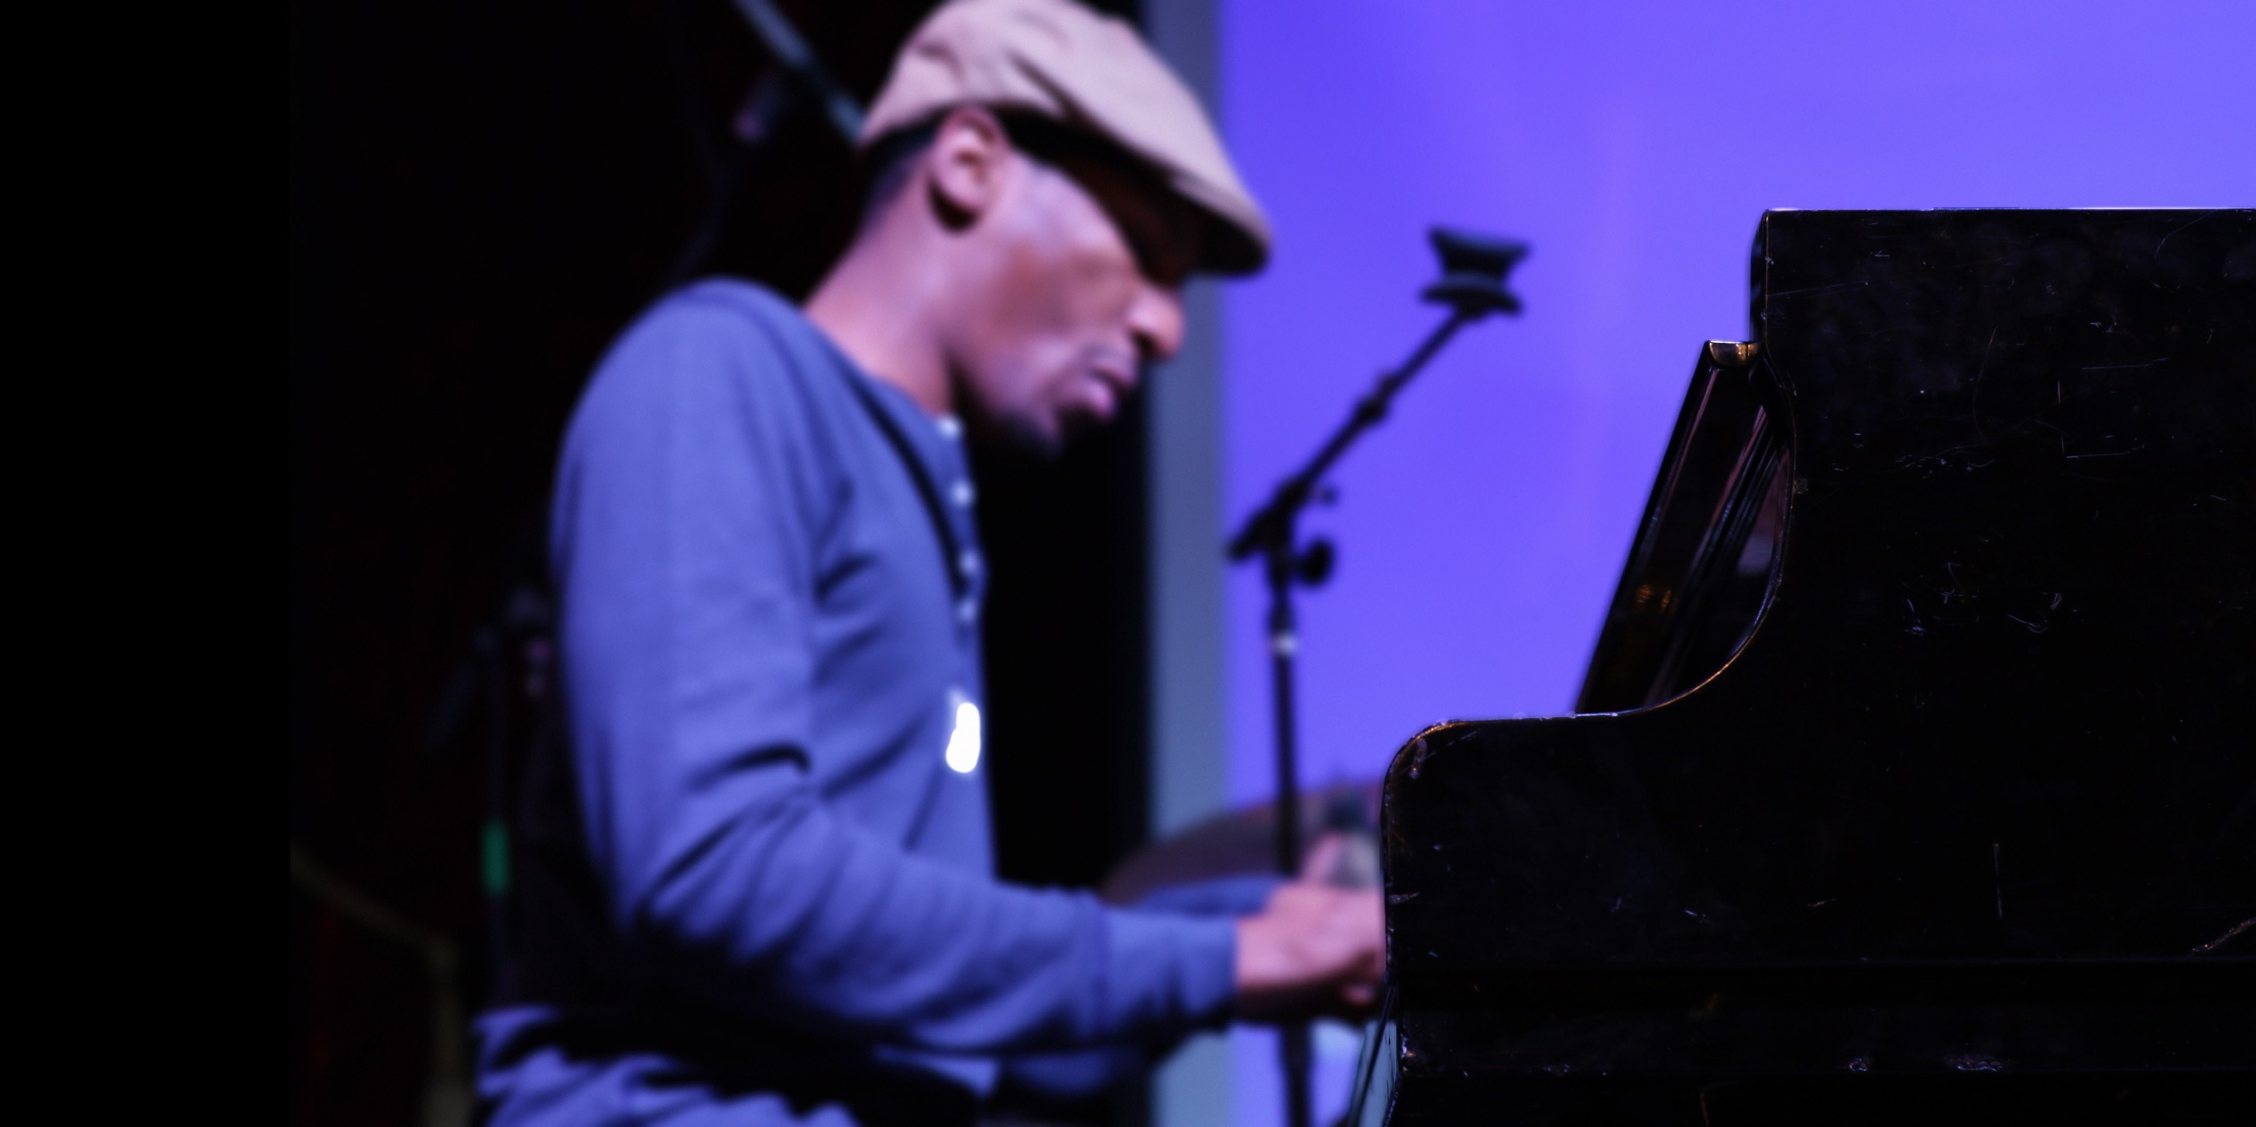
Key Message: Performing Artist
Establish health care relationship BEFORE needed
Perform for HCP so they understand your craft
Document a week of typical activities

Slide 11
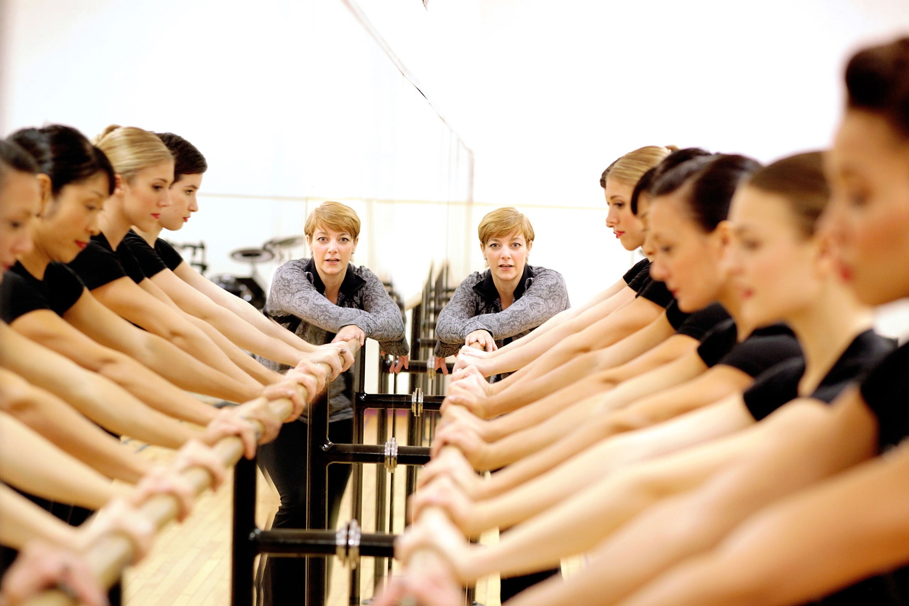
Key Message: Health Care Professional
Know if you are seeing a performing artist
Test for and educate about Noise-Induced Hearing Loss
Pre-Participation Physical Exam for performing artists

Slide 12
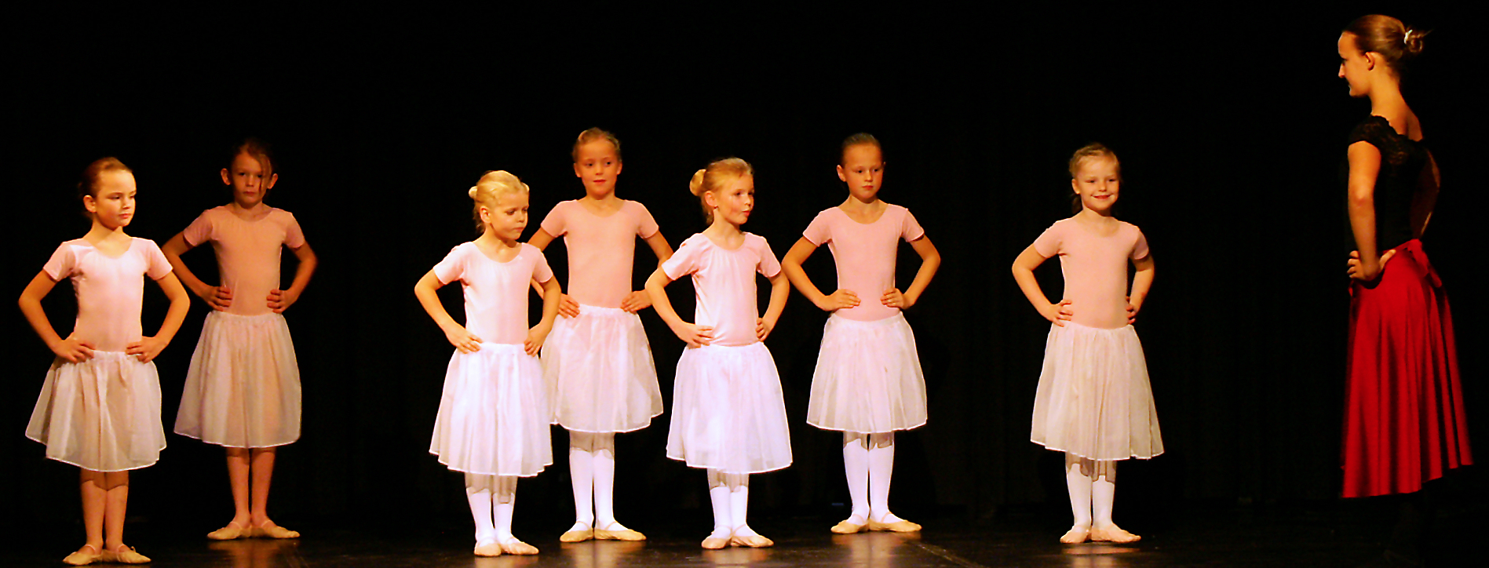
Key Message: Music/Dance Teacher
Be the Wellness Voice
Practice and performance in perspective
Discuss optimal performance, how to get there

Slide 13
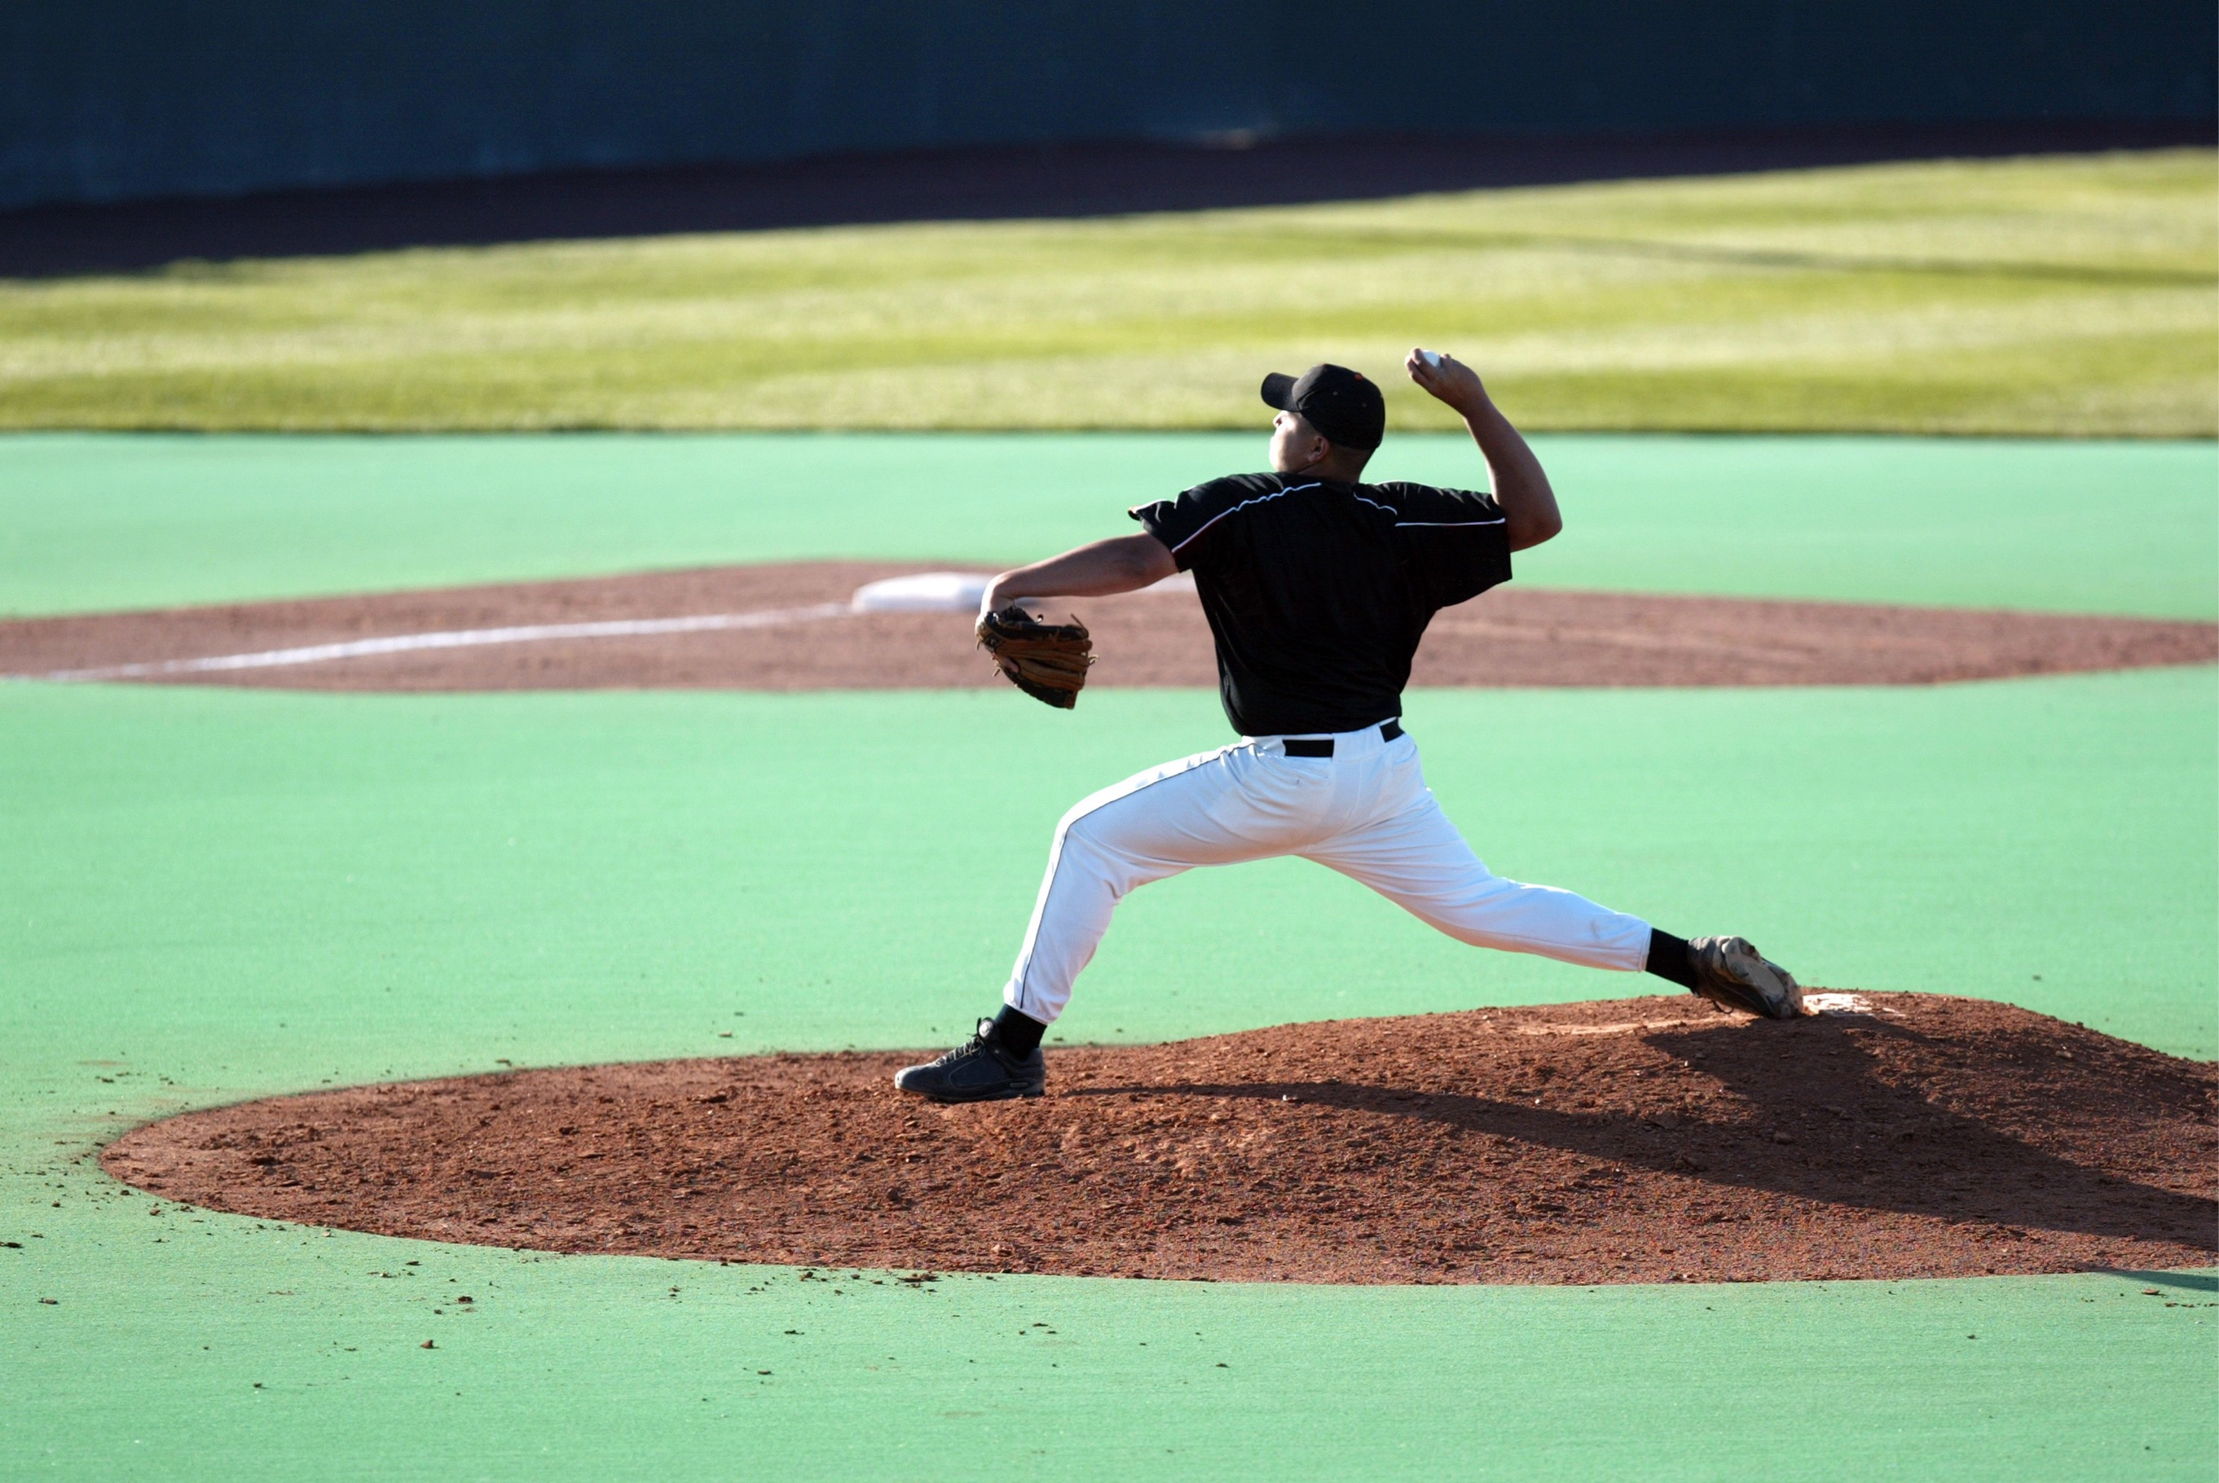
Repetitive Motion/Overuse
150 pitches per team in a professional baseball game
8,000 steps per field player in a soccer match
50,000 steps in a marathon

Slide 14
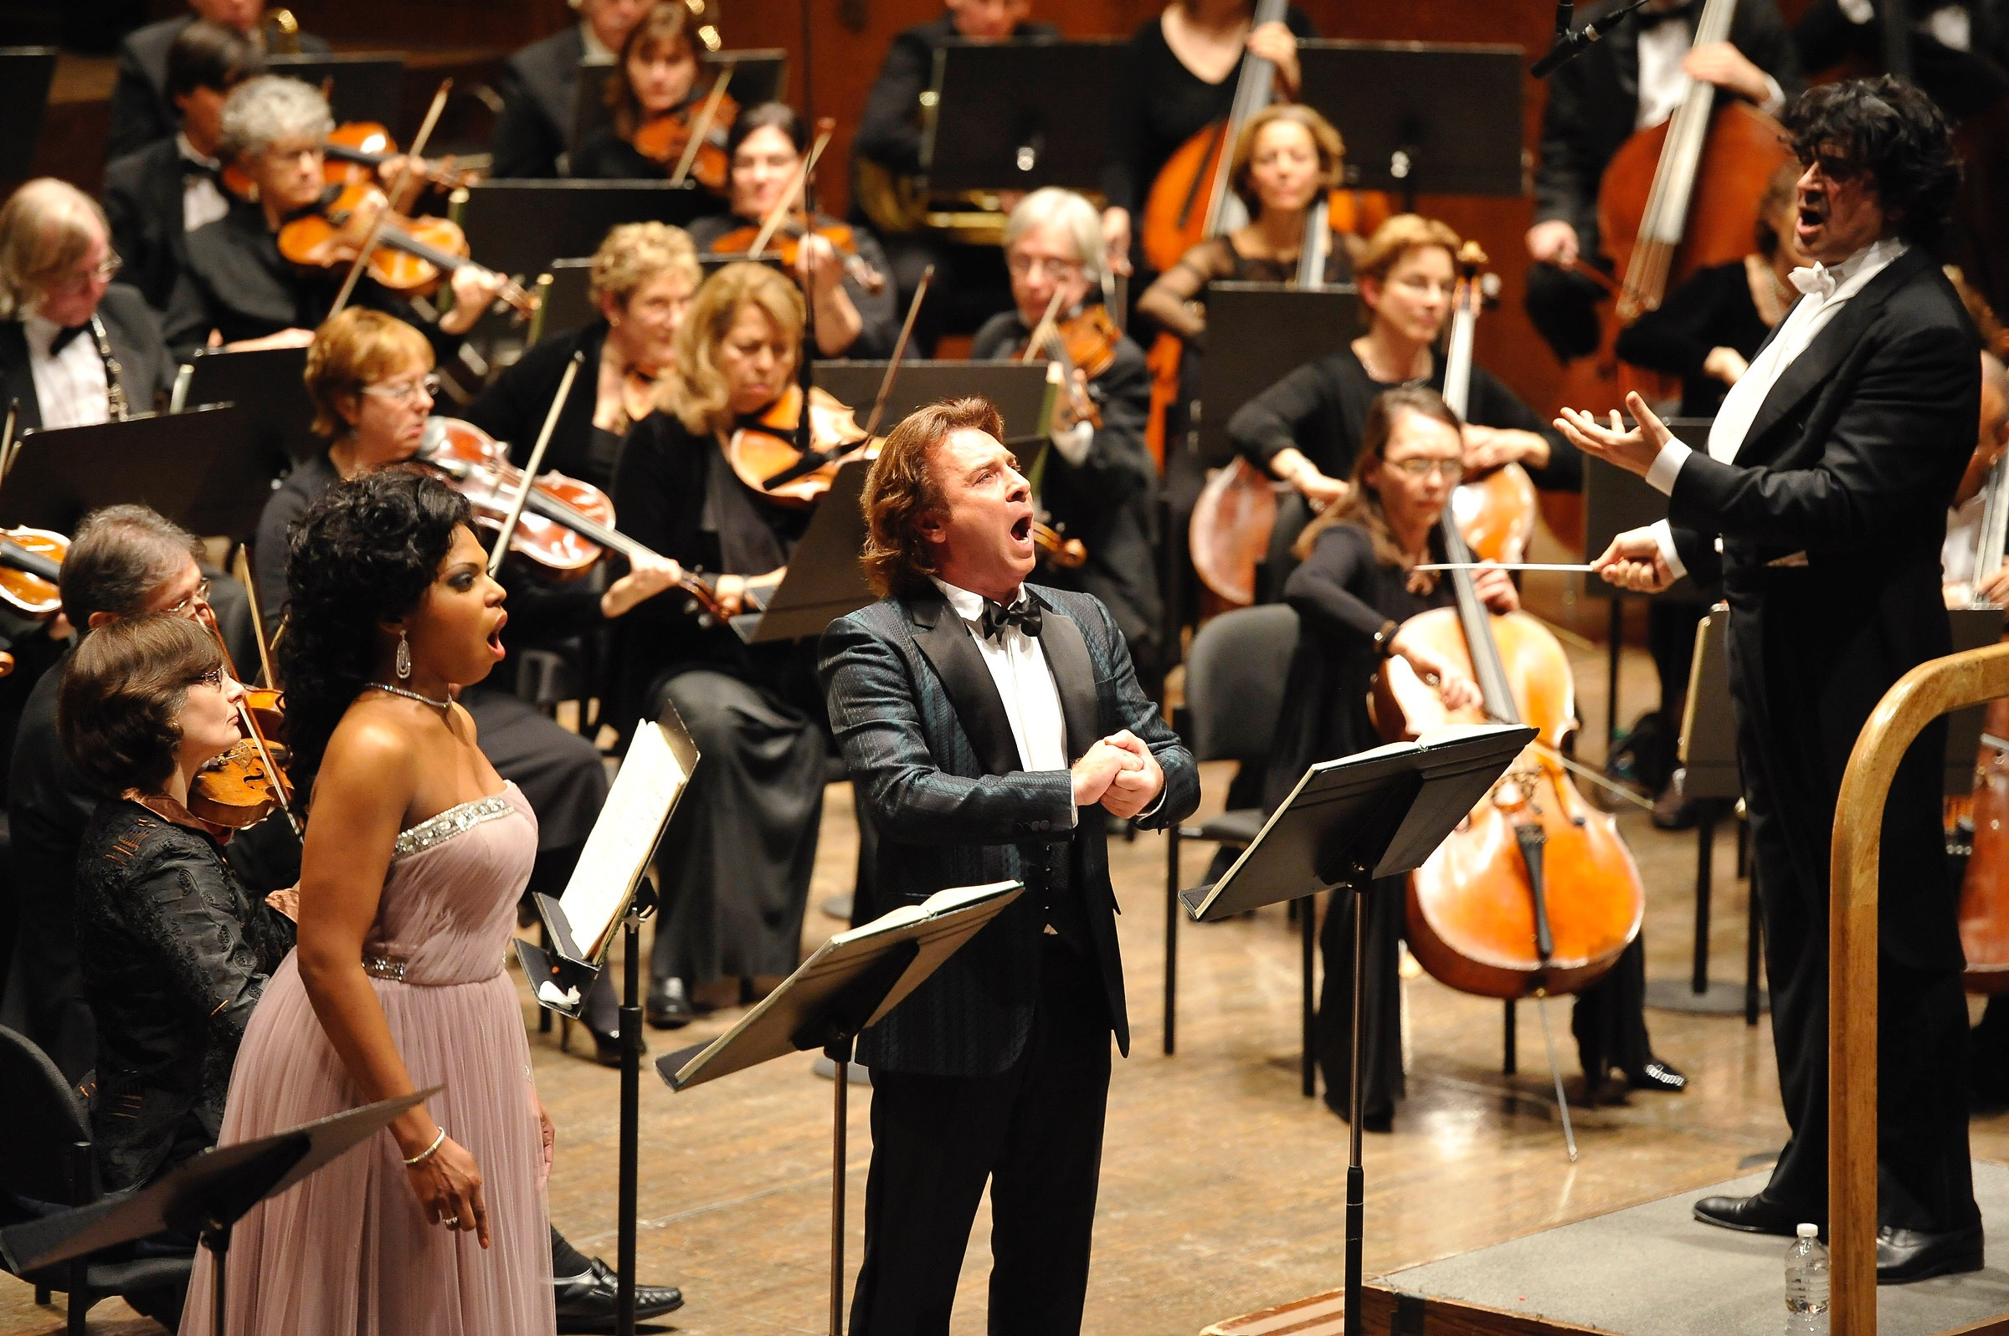
Repetitive Motion/Overuse
Dance steps in a Broadway show ??
Violin bow strokes in a movement ??
Notes sung in an opera ??

Slide 15
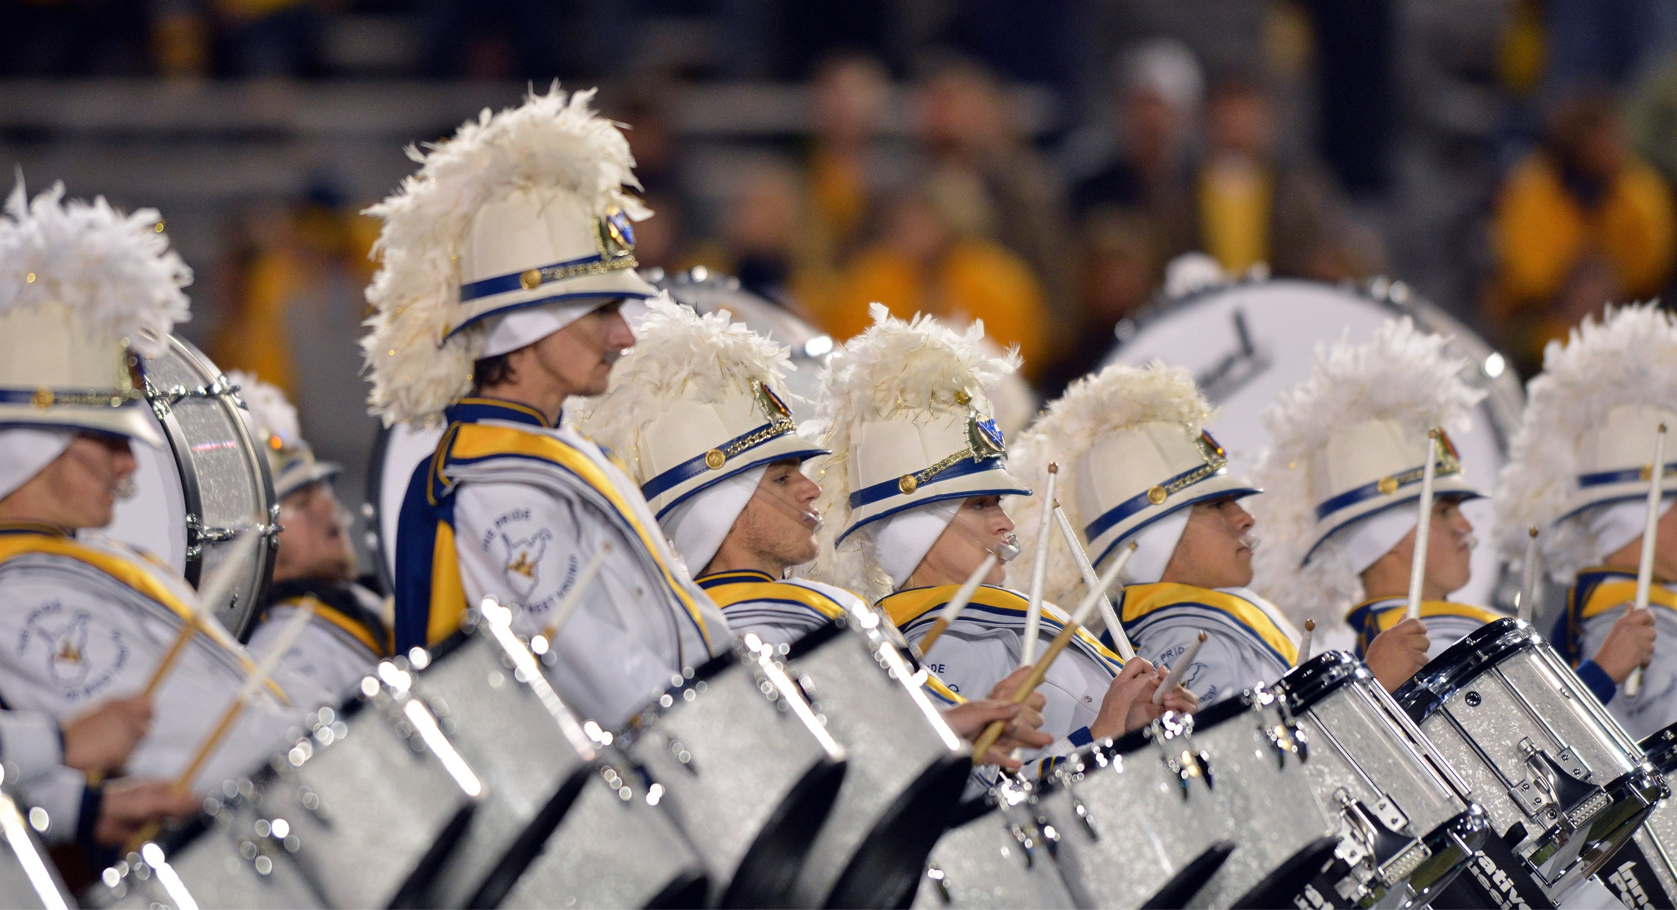
OVERUSE - Lessons From DCI
Elite drum corps are competitive units of adolescent and young adult marching musicians consisting of brass players, percussionists and color guard performers who perform difficult and physically demanding marching performances.

Slide 16
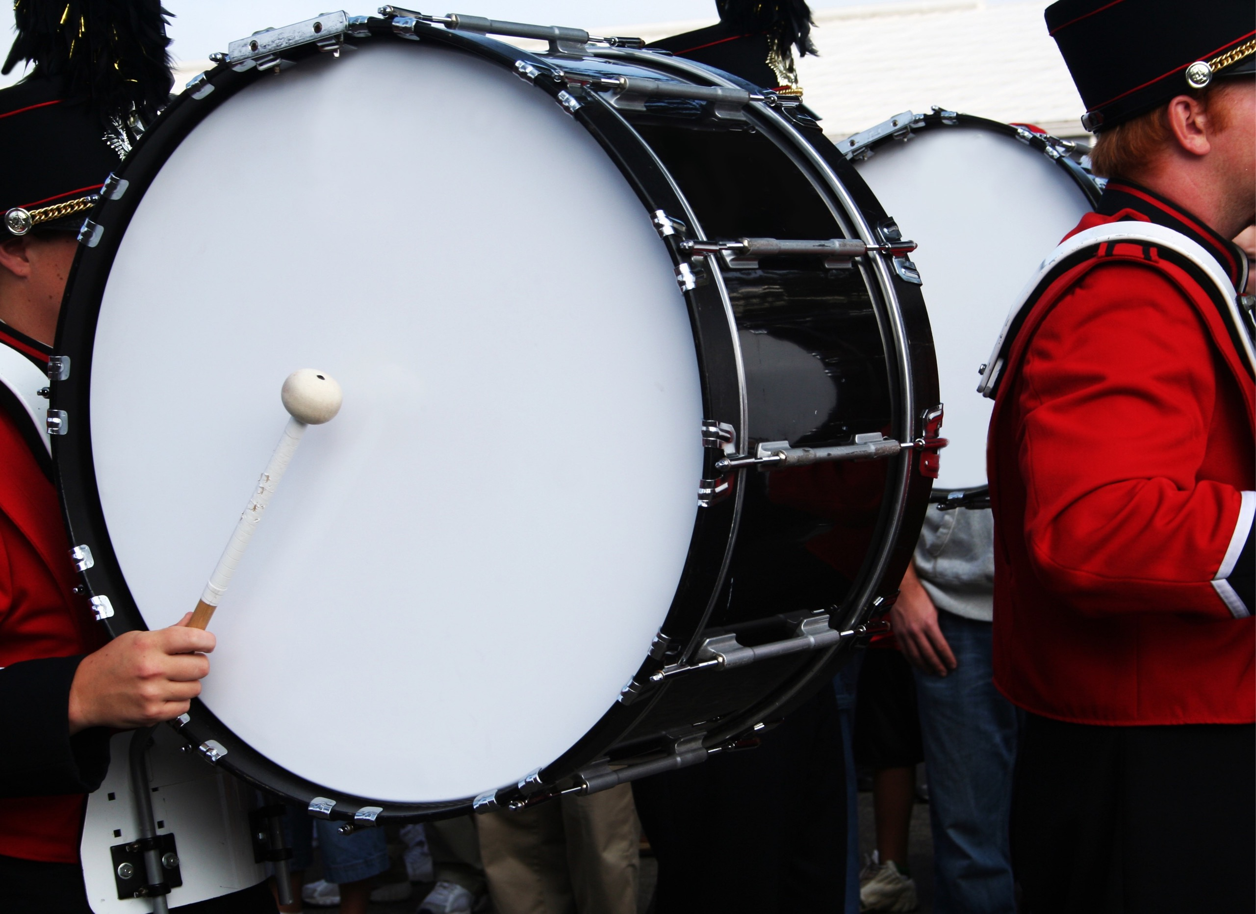

OVERUSE - Lessons From DCI
16 Participating units work to perfect a 10-12 minute visual/music program that is the subject of approximately 25 to 40 competitions during a national summer tour.

Slide 17
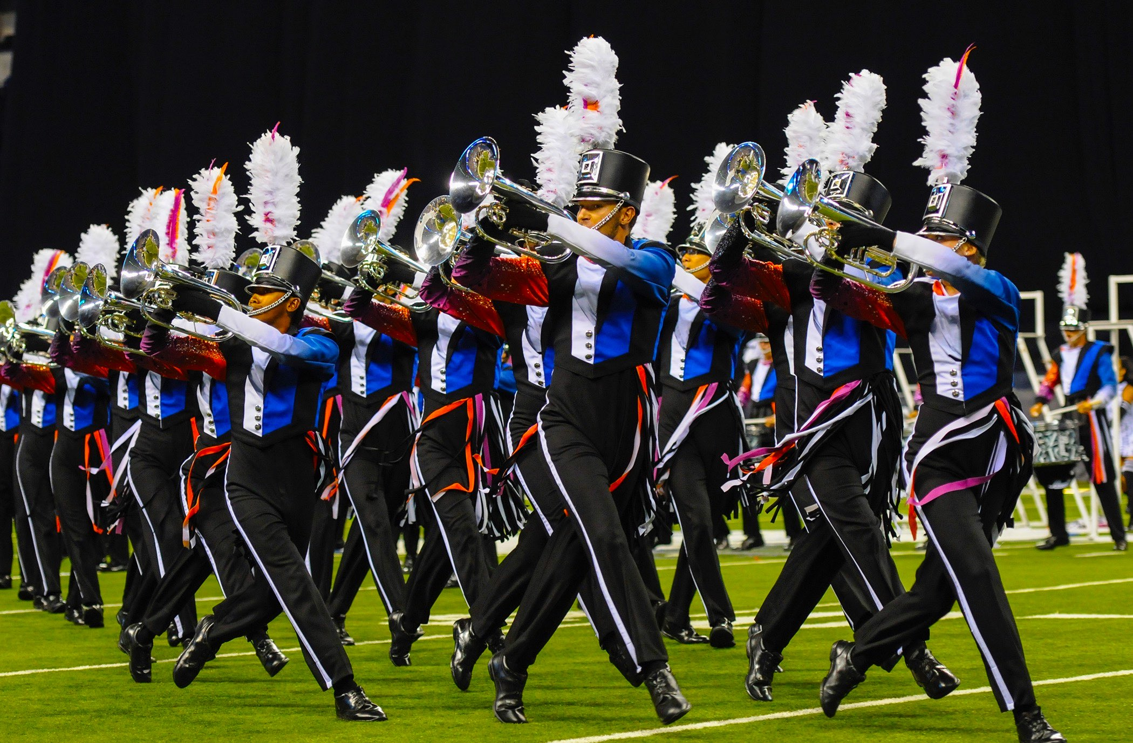
OVERUSE - Lessons From DCI
On competition days, units typically rehearse
for 1 or 2 rehearsal blocks (4-8 hrs)
Non-comp days, rehearse 2 or 3 rehearsal blocks (8-12 hrs)

Slide 18
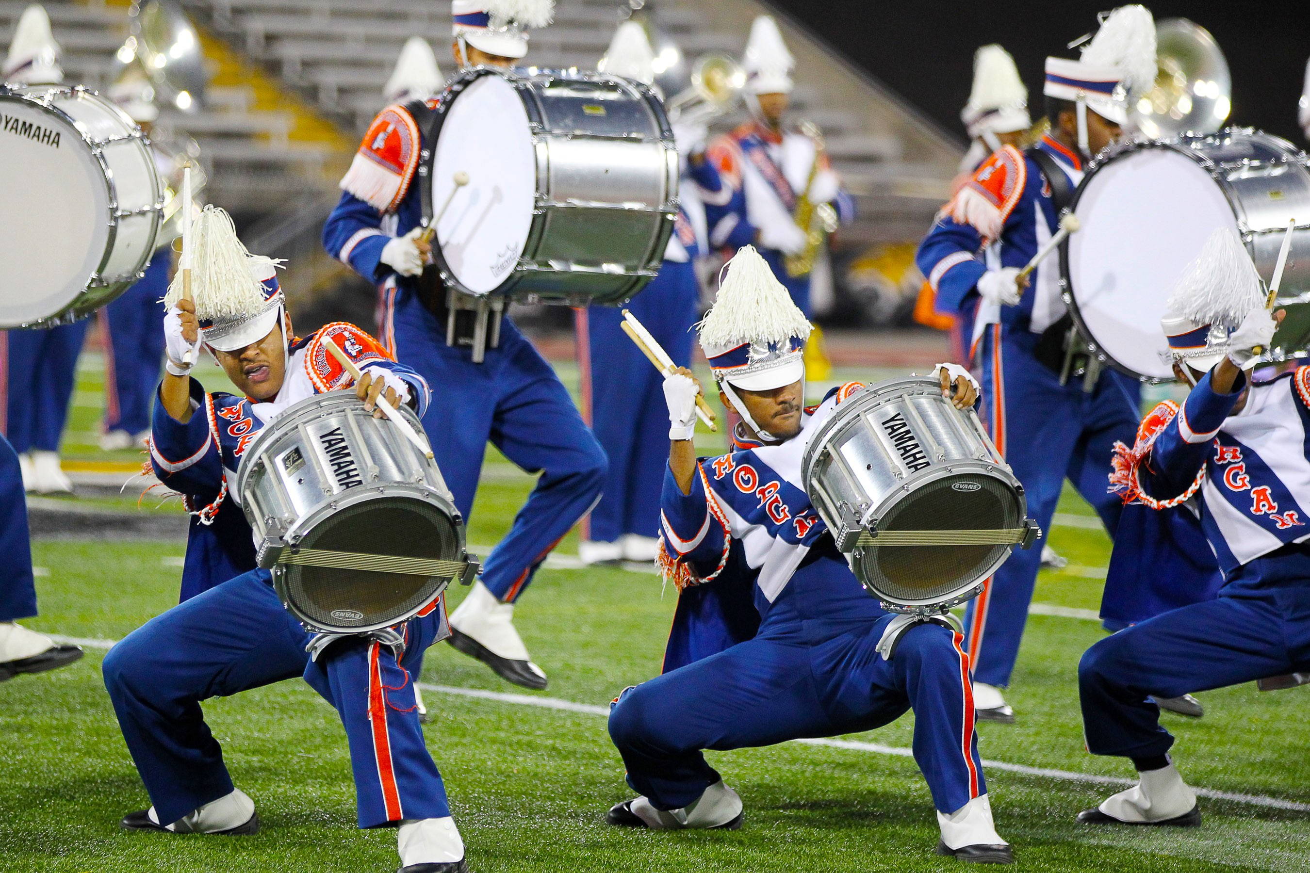
OVERUSE - Lessons From DCI
The musical programs performed are complex and demanding, typically requiring performers to play music while executing intricate marching maneuvers and choreography at speeds than can exceed 200 beats/min.

Slide 19
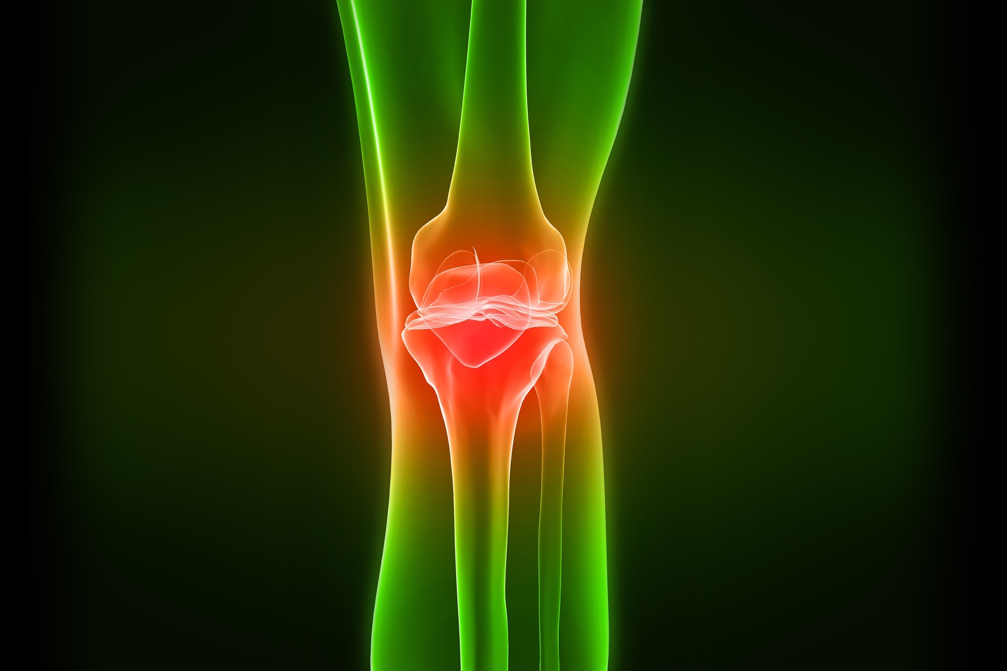
OVERUSE - Lessons From Sport
Risk factors for Knee Injuries in Children 8-15 yo
Junge T, L Runge, B Jull-Kristensen and N Wedderkopp, Med. Sci Sports Exerc., Vol 48, No. 4 pp 655-662, 2016
FINDINGS
10 sports over 3 years
Overuse knee injuries most common type
Intrinsic risk factors: female gender, previous knee injury
Extrinsic risk factors: sports participation > 2 times a week (traumatic AND overuse)
NCAA: 20 hours a week

Slide 20

Mental Health - Lessons from Sport
Youth in today’s culture are driven to train early and extensively. Early specialization and extensive training creates well-documented risks of over-use injury, burnout, stress, and less enjoyment in youth sports (Performers??)

Slide 21
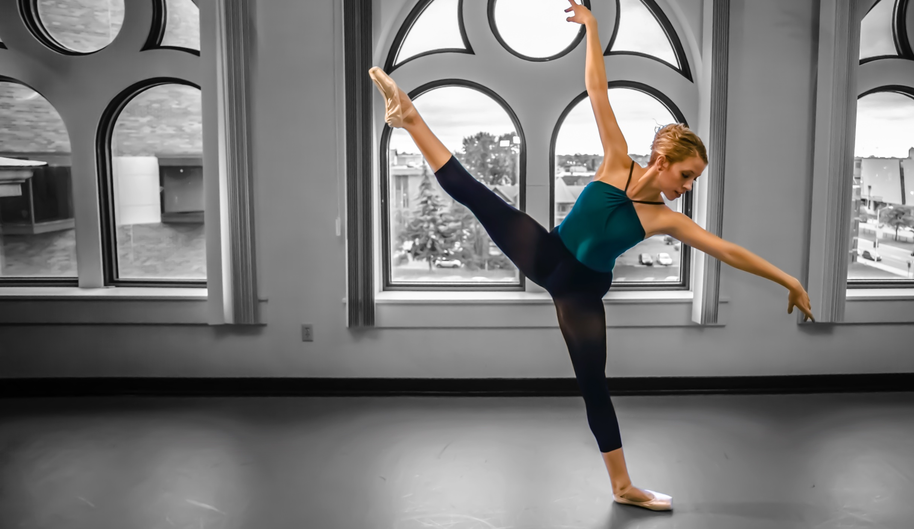
Practice and Performance
Lessons from Sport
Number of practice hours may hurt rather than help at some point
Consider FOCUSED practice segments with different goals in each session

Slide 22
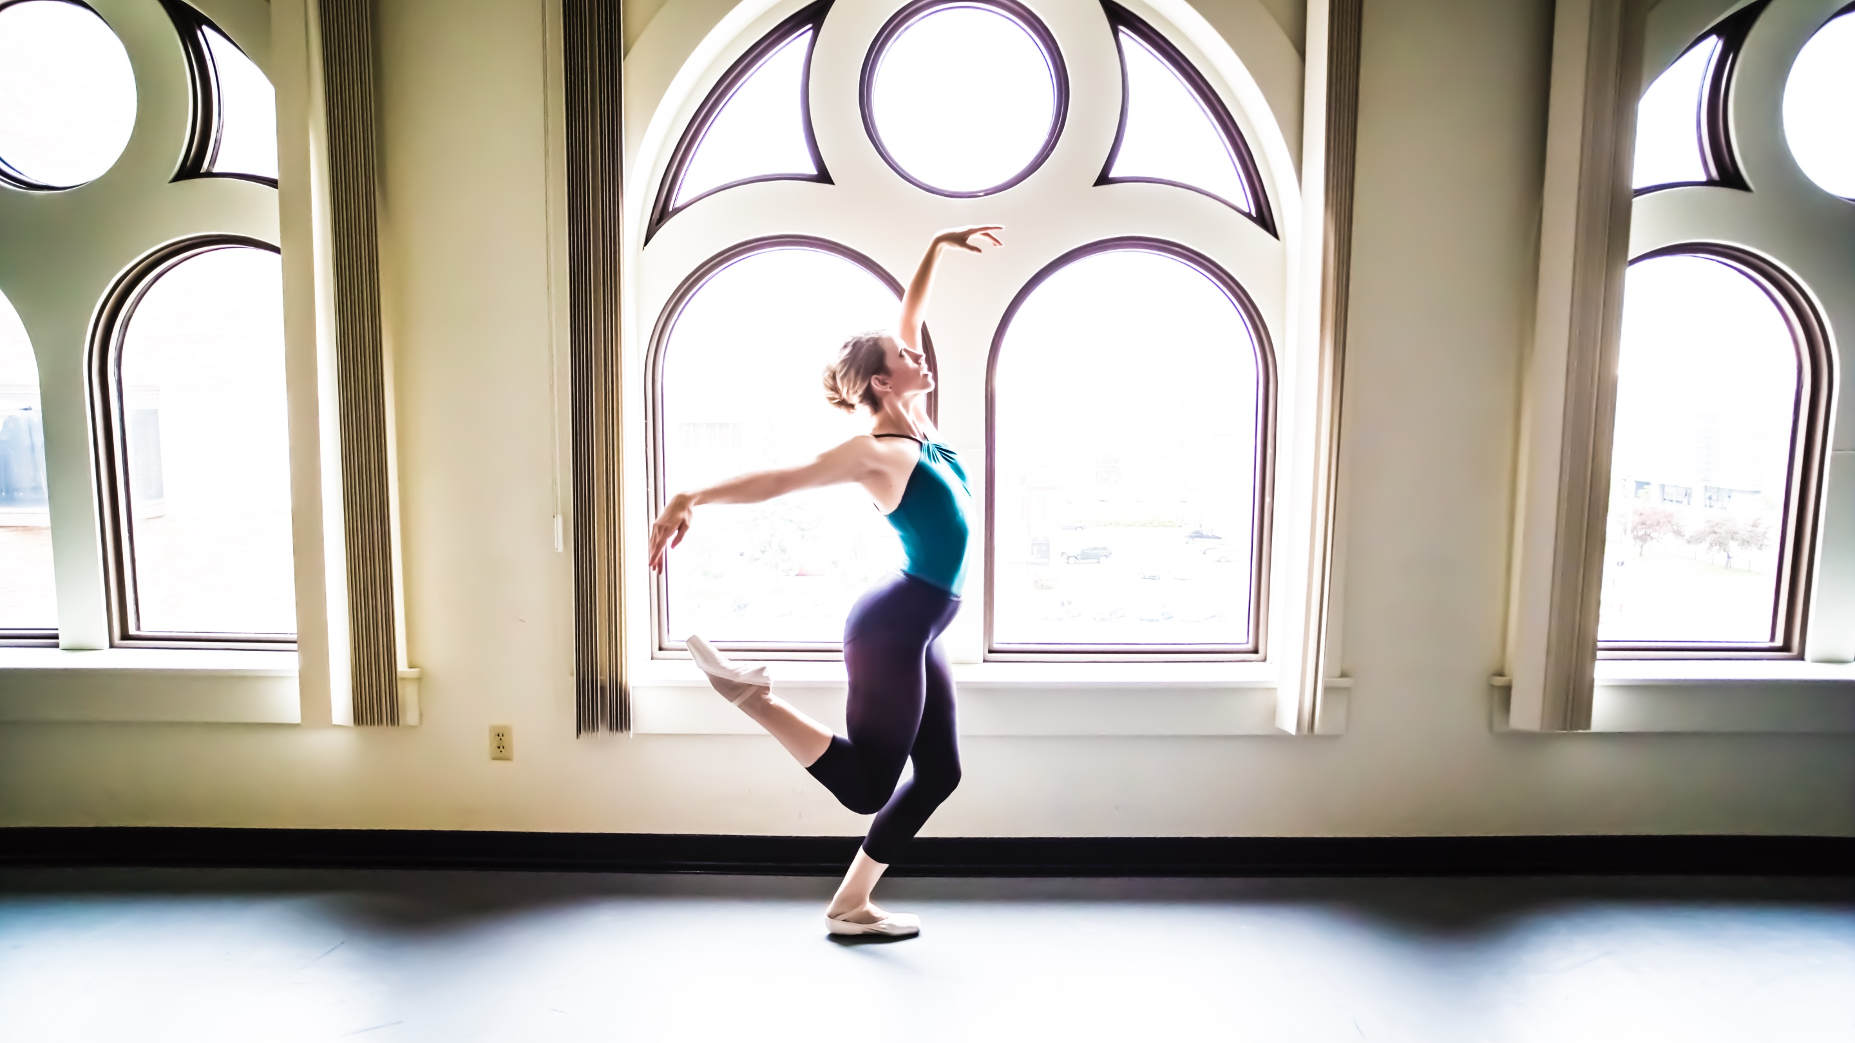
Practice and Performance
Lessons from Sport
Large ACUTE increases in time spent physically practicing increases risk of injury
If volume or intensity of practice must increase, do it gradually.

Slide 23
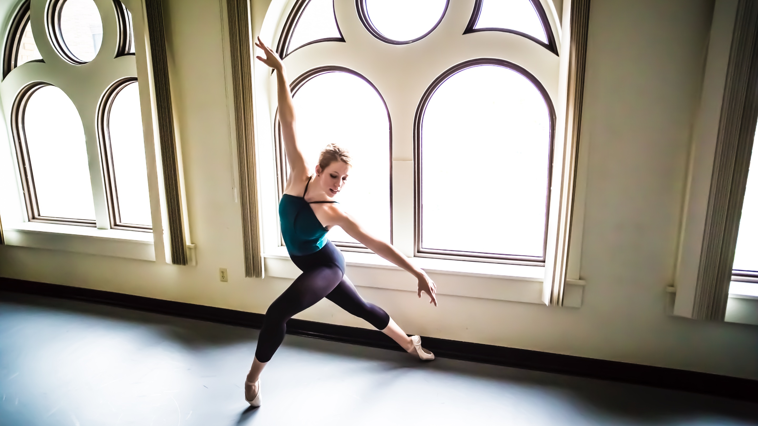
Practice and Performance
Lessons from Sport
Recovery /Cross-training
Employ mental or physical activity that lets body focus on something different
Emphasize both mental and physical rest and recovery

Slide 24
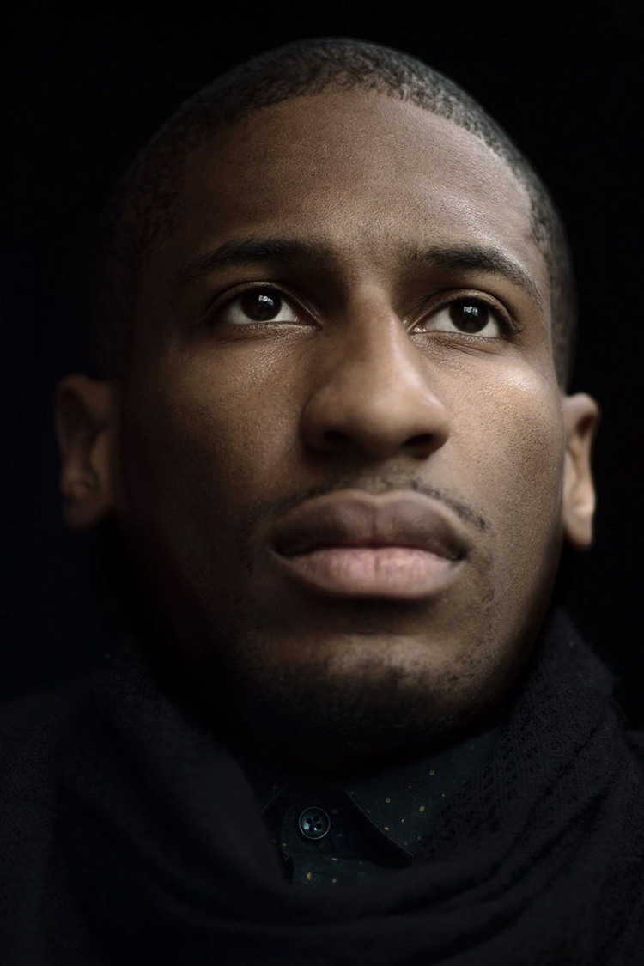
“The conservatory environment is very different. I went to Julliard six years and never in any of my lessons was there any instruction about nutrition or any sort of quantifiable method to determine the pros and cons of playing long hours. If I missed a note, I was just told to do it again, to practice more”.
Jon Batiste
Ambassador, Athletes and the Arts

Slide 25

Noise Induced Hearing Loss (NIHL)
May affect up to 50% of musicians
Safe—>85 Decibels/8 Hours (NIOSH)
For every 3 dBs over 85, time exposure is halved
    88 dB - 4 hrs/day
91 dB - 2 hrs/day
94 dB - 1 hr/day (Avg NFL game)
80 dB - alarm clock or busy street
90 dB - lawn mower
100 dB - snowmobile

Slide 26
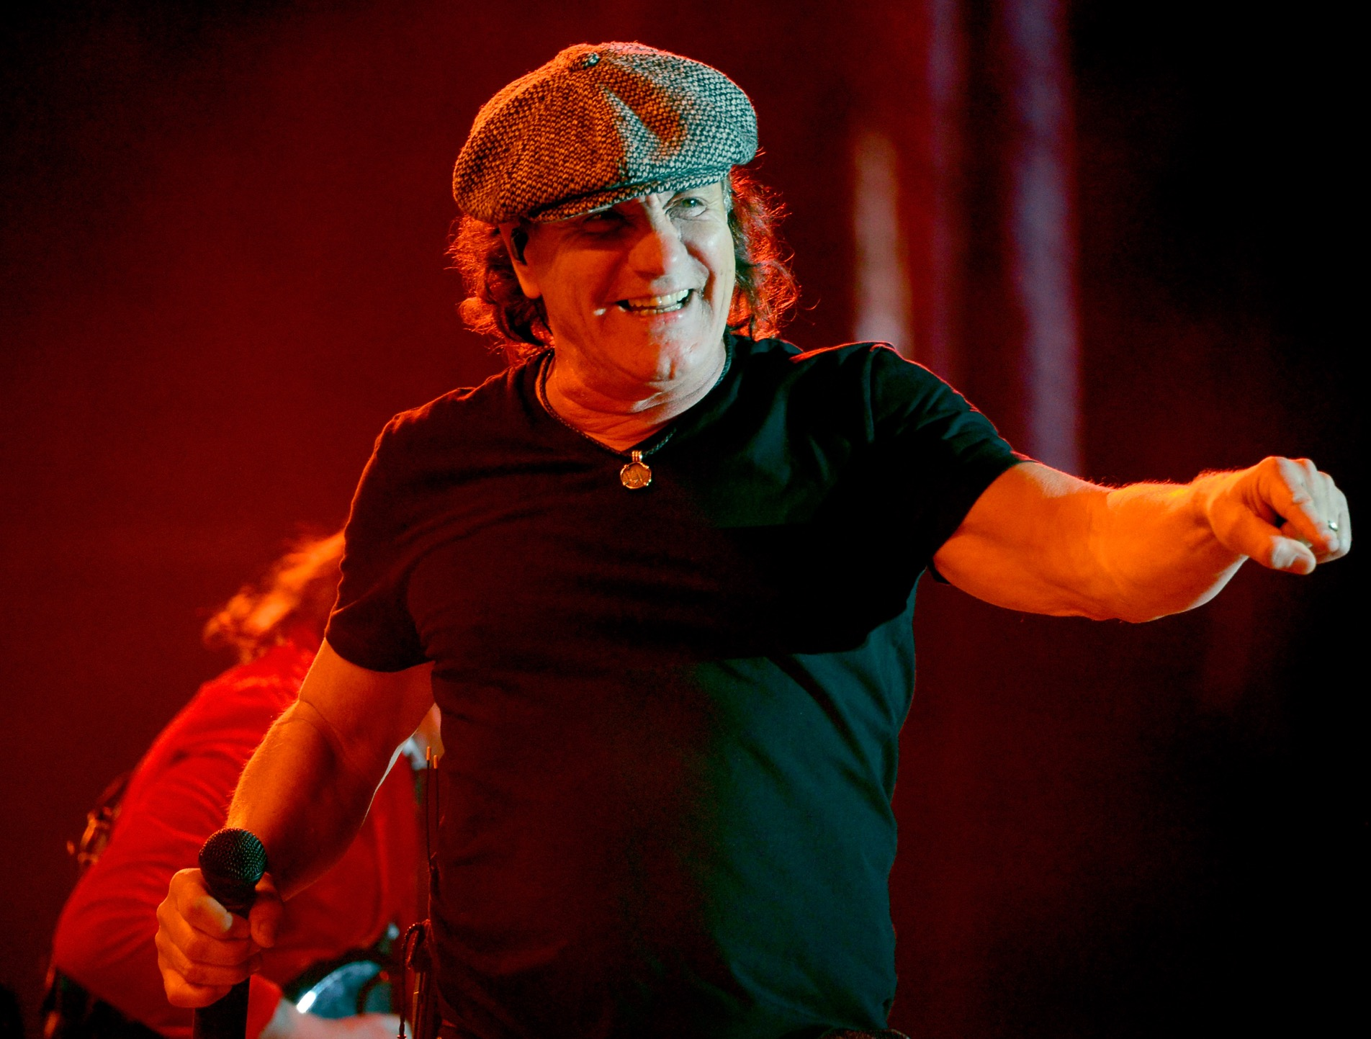
Noise Induced Hearing Loss (NIHL)
Many musicians practice 6-8 hours/day
Dynamic range of music, live or recorded, can peak at or above 95 dB
Hearing damage can occur when exposed to these volumes daily for 60 minutes or less

Slide 27
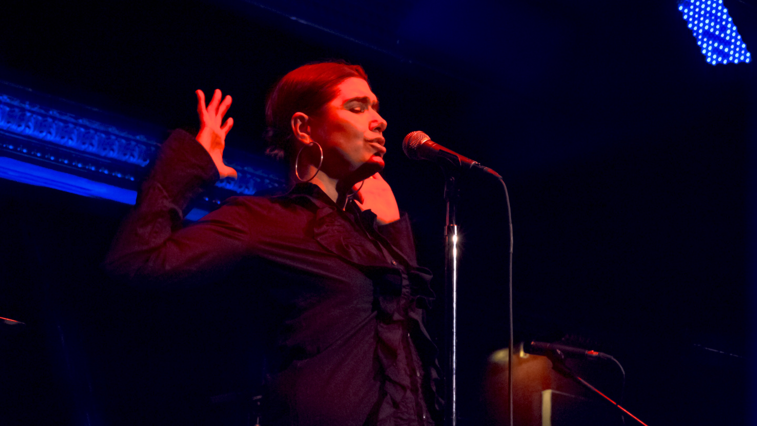
Optimal Performance
SPORT (objective)
PERFORMERS (subjective)
Measurement
Practice limits
Recovery
Specialization
Performance enhancement techniques
Score, win, time, measurable
Yes, based on safety and development research (NCAA, Little League, USA Football)
Incorporated, valued
Not encouraged
Diet, cross-training, video review, sports science
Judging, choreography, audience
NO formal limits
Not incorporated or valued
Encouraged
Little application of proven techniques

Slide 28
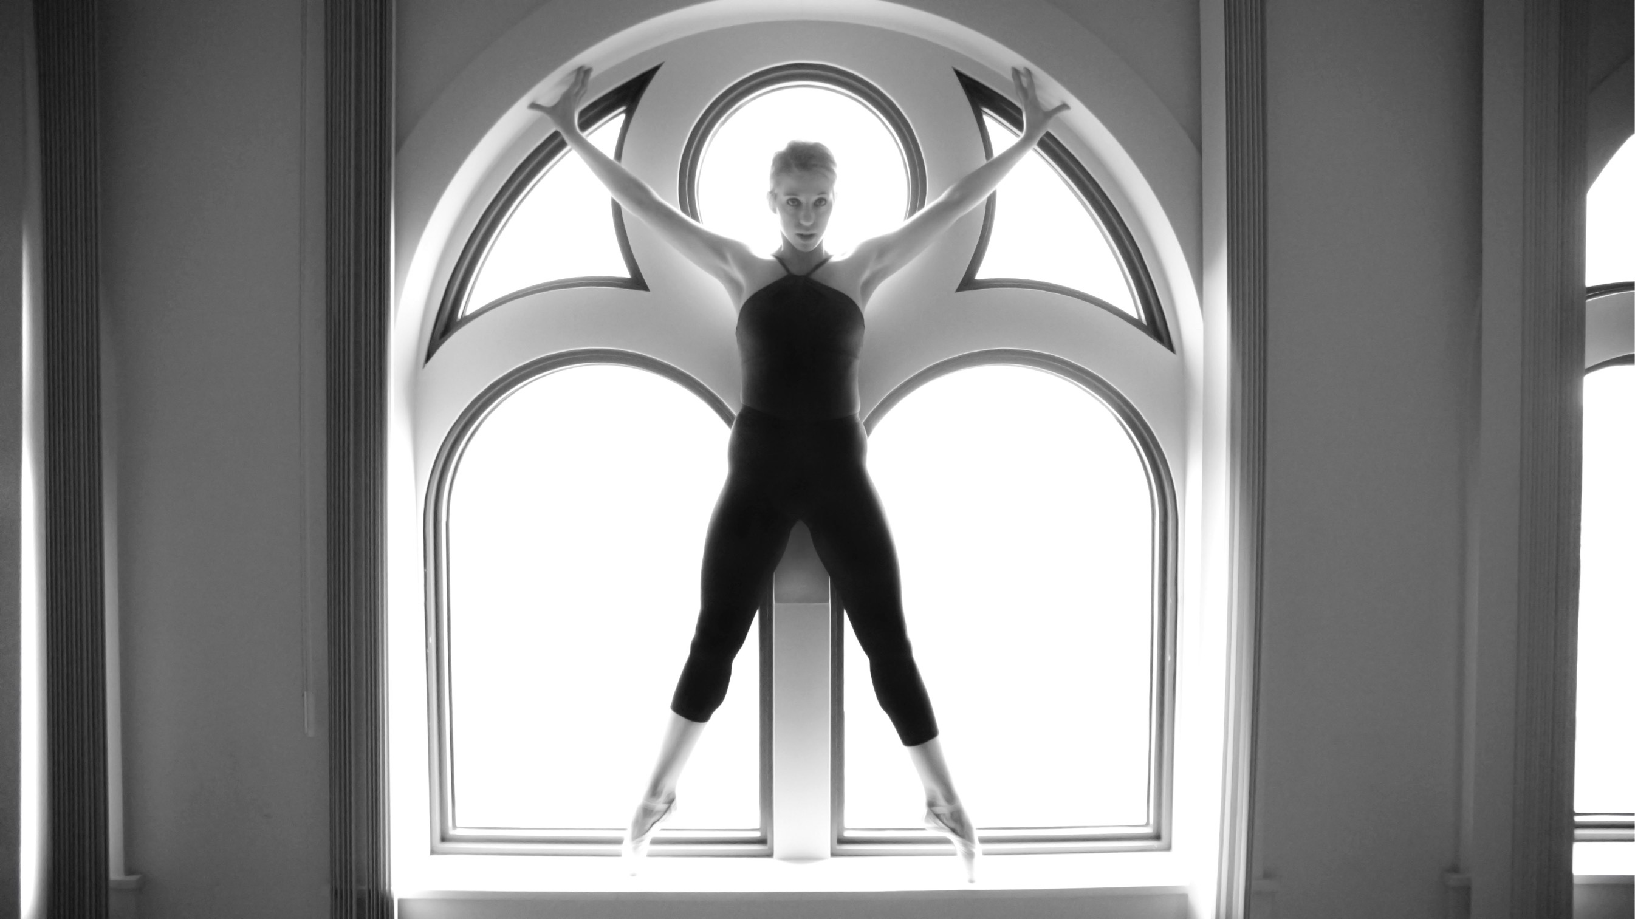
Athletes and the Arts
Opportunities and Resources
Notes:
Up to 50% of performing artists may have a hearing problem before the end of their careers. Early education and screening should be required, similar to a concussion screening for a sport athlete. Emphasize that music volume RANGES from about 60 –over 100 dB The risk of CUMULATIVE exposure to volumes over 85 Db is where the problems come. With the long hours of daily practice, many musicians are at risk. Domed stadiums or loud rock concerts can be over 110 Db.

Slide 29
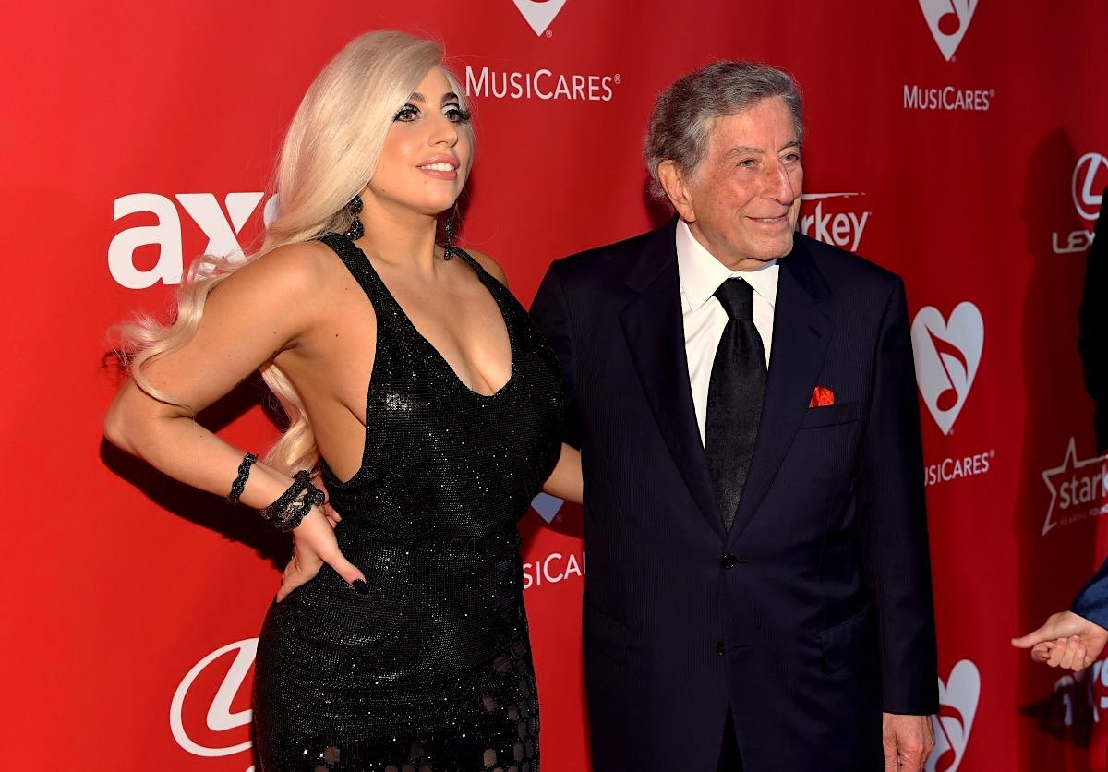
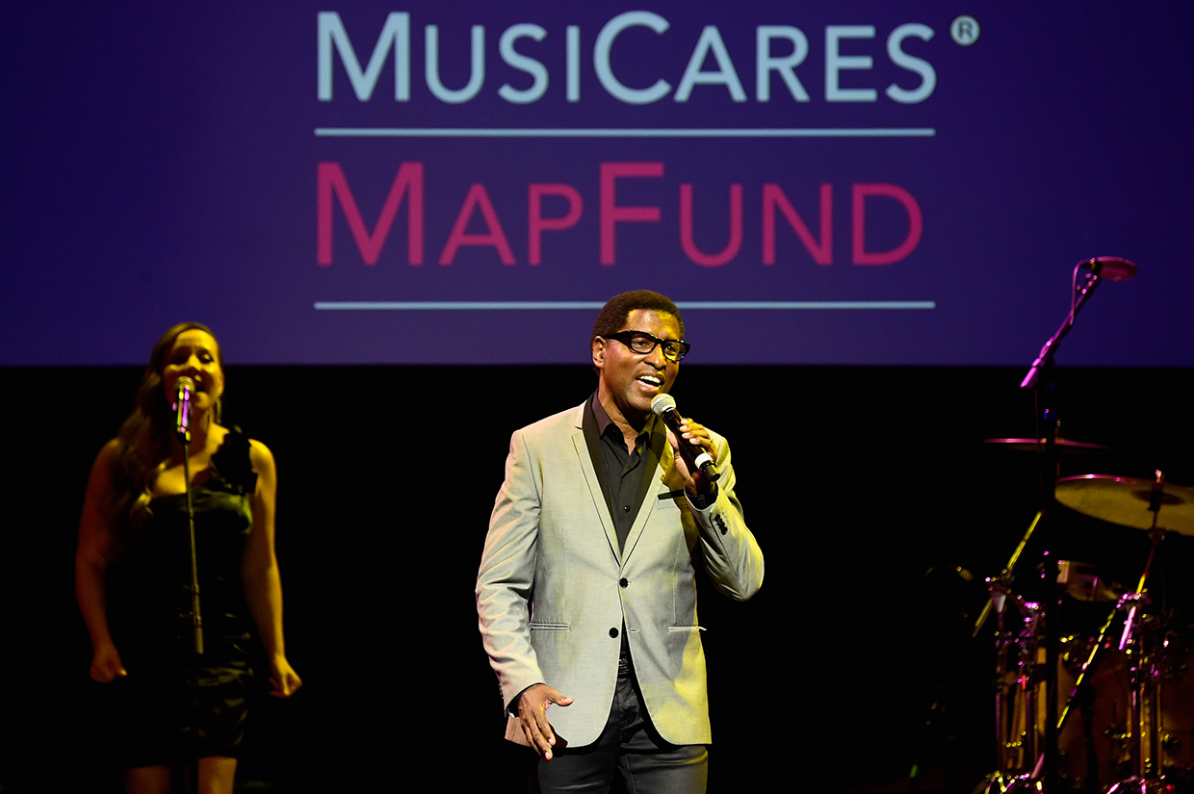
OPPORTUNITIES
Grammy MusiCares - A medical network of health providers who volunteer care or provide reduced rates to the many musicians who cannot afford medical care or insurance

Slide 30

OPPORTUNITIES
U.S. Council of Mayors – 2017 AATA initiative
City of Boston has ongoing template program

Slide 31

National Association of Schools of Music (NASM) Standard - Nov 2011
“It is the obligation of the institution that all students in music programs be fully apprised of health and safety issues, hazards, and procedures inherent in practice, performance, teaching and listening.
Music program policies, protocols, and operations must reflect attention to injury prevention and to the relationships among musicians’ health.
Specific methods for addressing these issues are the prerogative of the institution. Existing resources prepared for NASM include:
Hearing / Musculoskeletal / Mental health

Slide 32
OPPORTUNITY
(Contact your local NASM school)
To address health and safety issues
(including applying EXERCISE IS MEDICINE® concepts)
In 644 schools of music nationwide
(100,000 music students annually)
Who then impact a new generation of musicians
(through teaching)
Or the professional performing arts community
(through performing)

Slide 33
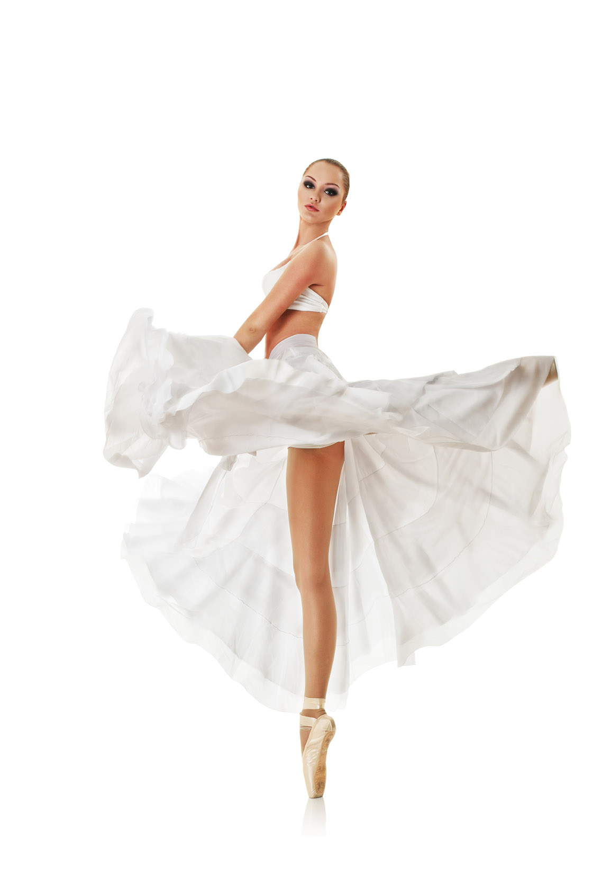

DEVELOPING RESOURCES
Performing Arts Pre-Participation Physical Exam
PAMA: DIVA exam (Dancer, Instrumentalist, Vocalist, Actor)
Similar to sports medicine PPE
Goal: catch problems before they interfere with activity or affect health
Performing Arts Wellness Certification

Slide 34
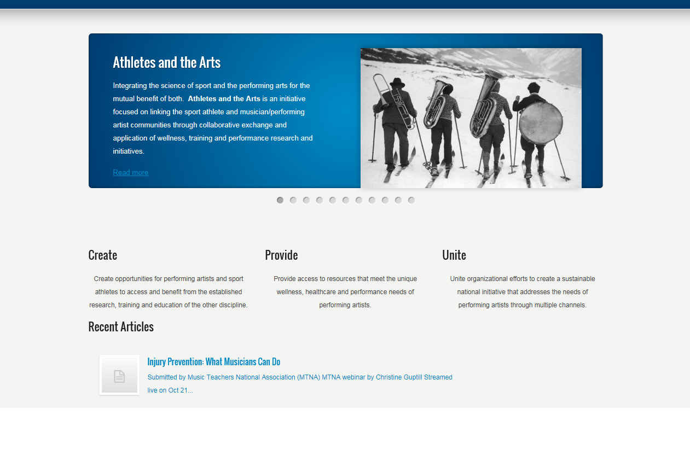
RESOURCES
(www.athletesandthearts.com)
Notes:
National Association of Schools of Music - NASM (644 schools within the US) brings an opportunity for health care professionals to postively impact music education by sharing your wellness expertise with local schools of music. The standard requires they address this. In many cases, they may not know how, They NEED your help.

Slide 35
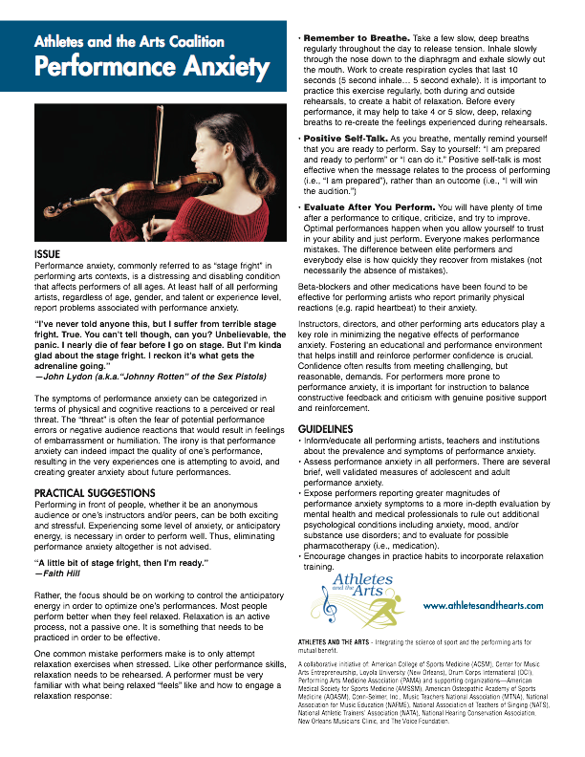
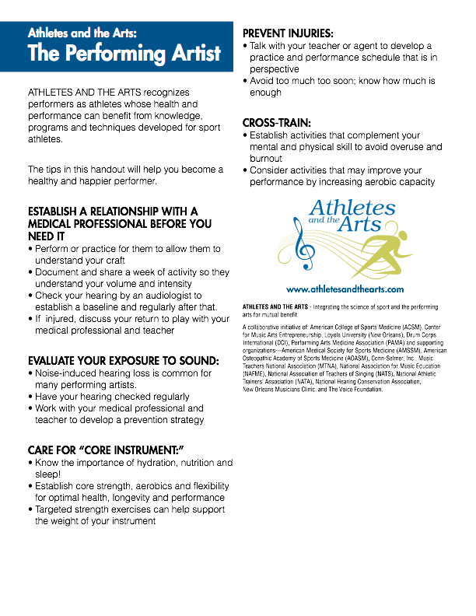
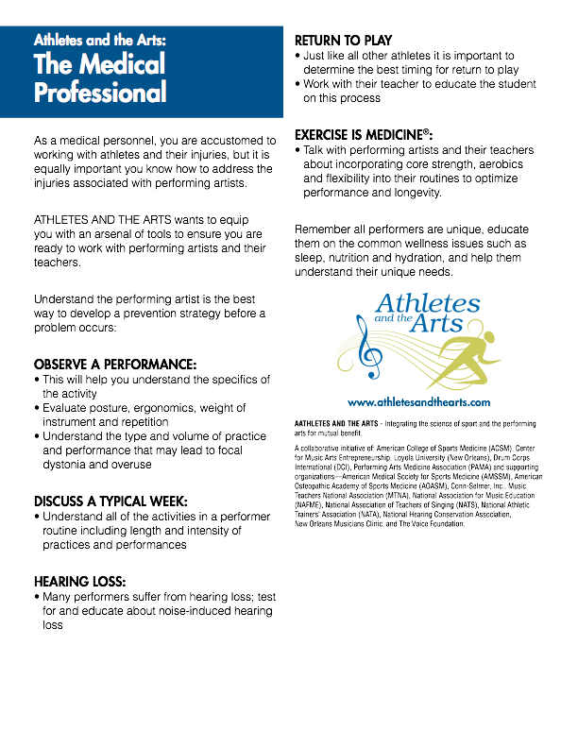
RESOURCES
Notes:
This impact can make a huge difference in our future performers and teachers.

Slide 36
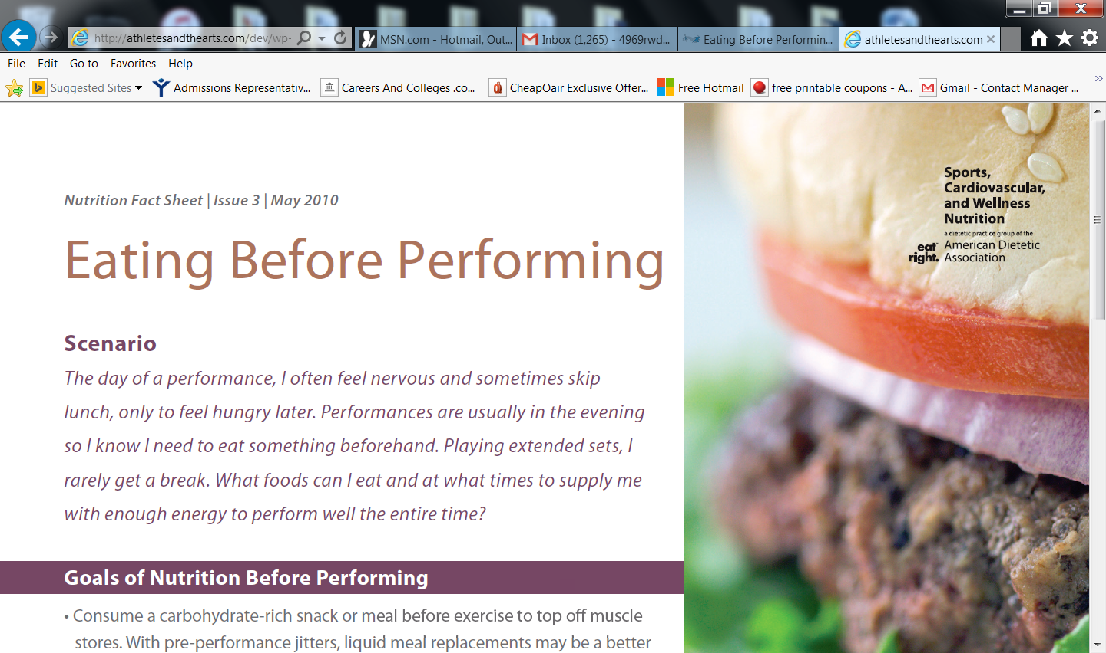

Slide 37

AN UNDERSERVED POPULATION
Poor access to care
Few knowledgable
health professionals
Sports med resources
applicable to artists

Slide 38
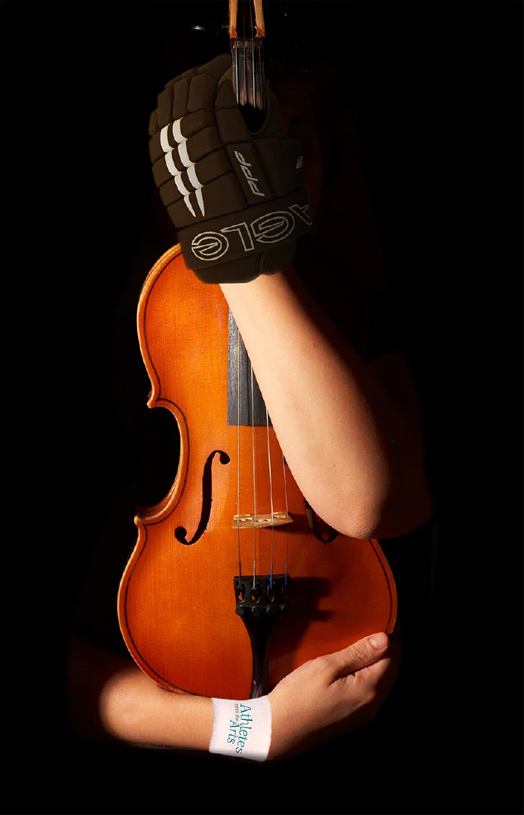
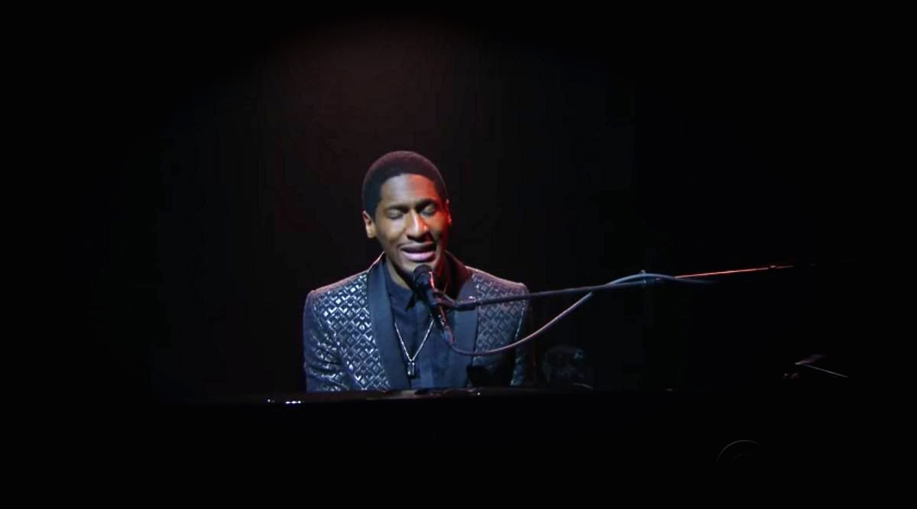
“…Music is healing and if you want to heal other people, you’ve got to heal yourself first. The healthier we are as musicians and the arts community in general, the better the world will be.”
- J.B.

Slide 39
BACK UP SLIDES

Slide 40
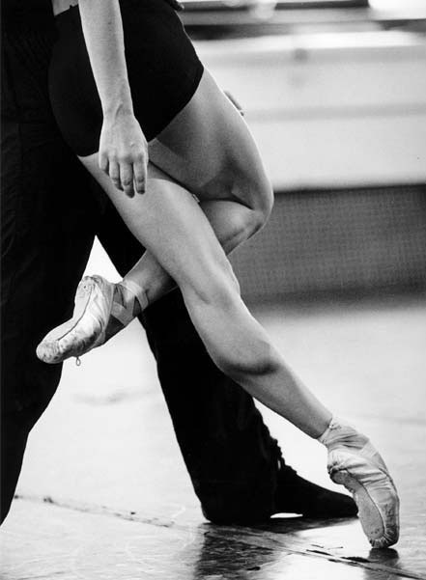
Dance Medicine
Now and Future
Dancers: elite athletes, short careers
High injury rates
Over-use injuries most common
Female Athlete Triad
Psychosocial stressors affect performance
Focus on injury prevention
Notes:
The vast majority of injuries are the result of overuse as opposed to trauma. Stress fractures, tendinitis, strains and sprains.
As in sport, the most common traumatic injury is ankle sprain.

Slide 41
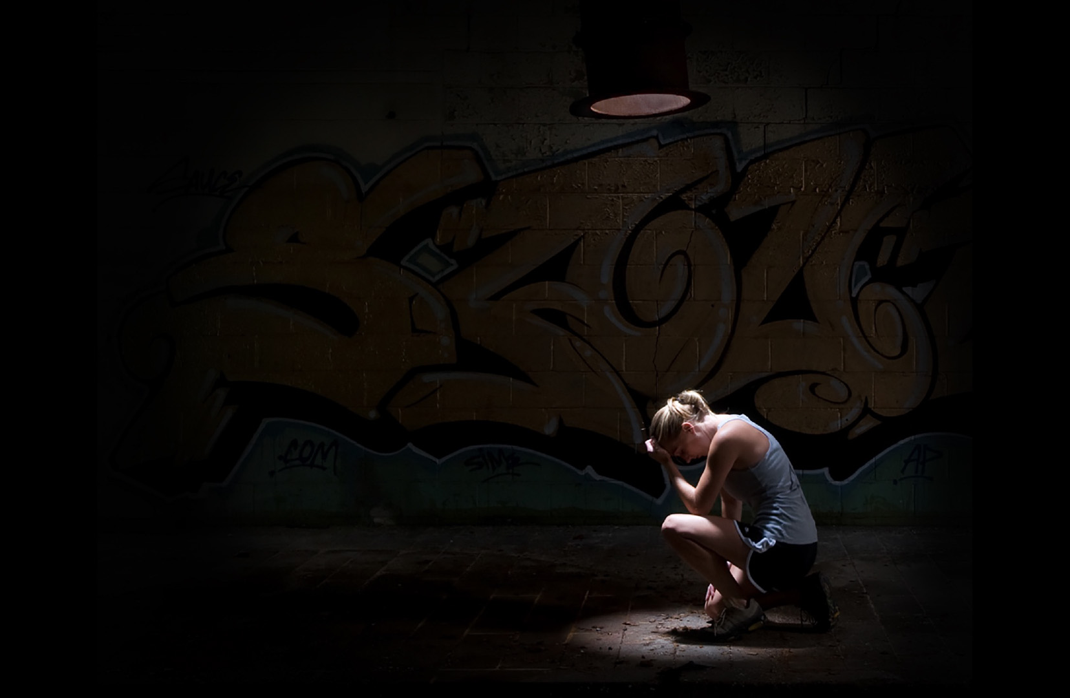
Mental Health - Lessons from Sport
Young athletes often are ill-equipped physically, socially, and psychologically to handle the rigors of intense training and make informed decisions about their training path.

Slide 42

Mental Health - Lessons from Sport
Daily training demands in addition to academic and other social activities can exhaust children. Sleep specialists recommend that adolescents sleep up to 9 hours per evening. Yet, under intensive training regimens, such rest is virtually impossible unless other critical aspects of a young adolescent’s life are sacrificed.

Slide 43


NIHL v Concussions
Hard to notice, brain function changes slowly
Understand the exposure to risk
Get baseline test
Recheck on regular basis
Use preventive measures when appropriate

Slide 44
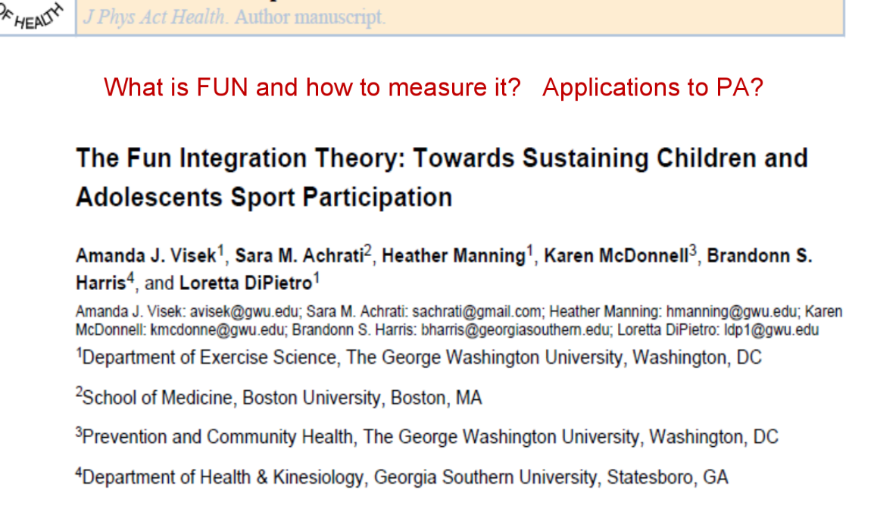

Slide 45
